Slide 1

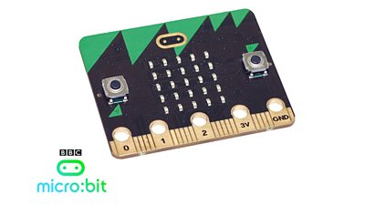
Micro:bit – 03
Lehel István KOVÁCS, PhD.
Sapientia Hungarian
University of Transylvania

Slide 2
8. Robotic arms

Slide 3
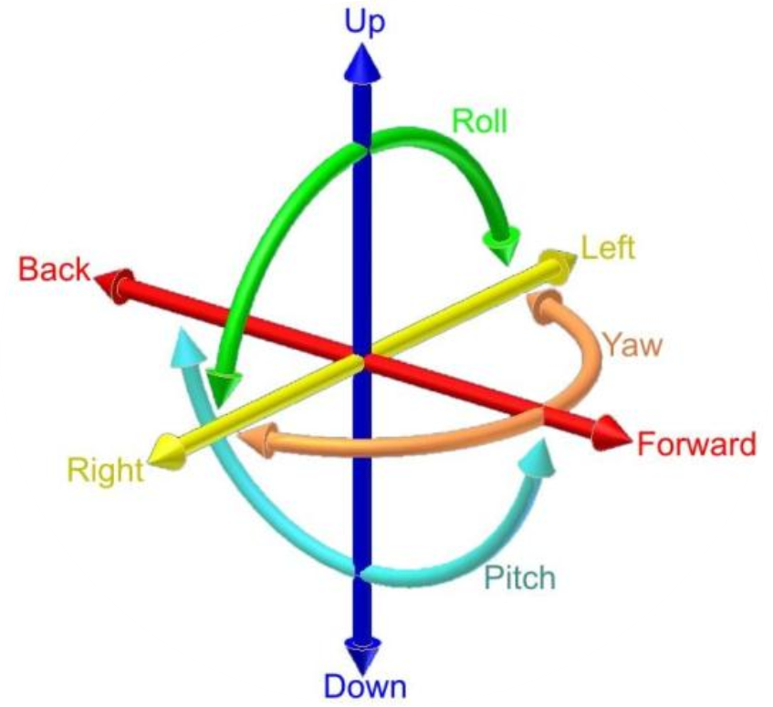
DoF
DoF: Degrees of freedom – the number of basic ways a rigid object can move through 3D space.
Rotations
  Roll
  Yaw
  Pitch

Slide 4
DoF :: robotic arms
A DoF as it relates to robotic arms, is an independent joint that can provide freedom of movement for the manipulator, either in a rotational or translational (linear) sense.
Every geometric axis that a joint can rotate around or extend along is counted as a Single Degree of Freedom.
rotation and translation

Slide 5
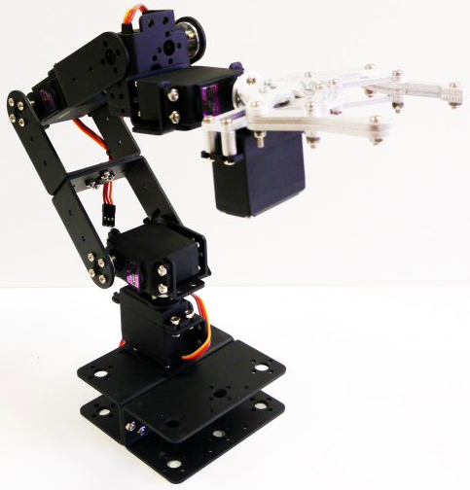
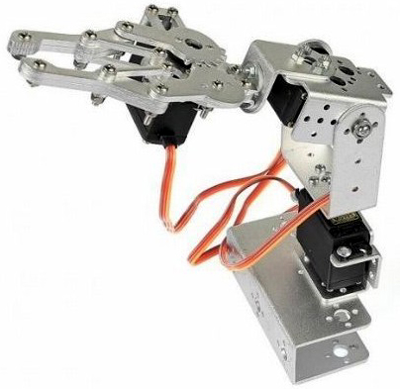
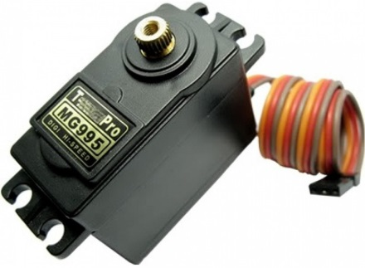
Robotic arms
Notes:
3 DoF, 6 DoF

Slide 6
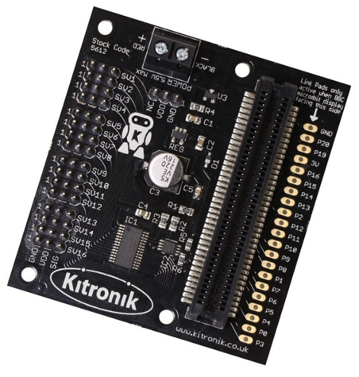
Micro:bit
Motor driver
  16 servos
  Supply Voltage: 3V–12V
Calculate the current intensity:
  The MG 995 motor needs:
    Operating voltage range is 4.8 V to 7.2 V.
    Current draw at idle is 10mA,
    No load operating current draw is 170mA,
    Current at maximum load is 1200mA.
    6 motors X 1200mA = 7200mA = 7.2A
  We need a power supply of 5–7V and 8–10A

Slide 7
9. Robot control

Slide 8
Bone/joint systems
A character (or robot) is represented in two parts:
  a surface representation used to draw the character (called skin or mesh) and
  a hierarchical set of interconnected bones (called the skeleton or rig) used to animate the mesh.
This technique is used by constructing a series of bones.
Each bone has a three-dimensional transformation (which includes its position, scale and orientation), and an optional parent bone.
The bones therefore form a hierarchy.
The full transform of a child node is the product of its parent transform and its own transform.
So moving a thigh-bone will move the lower leg too.
As the character is animated, the bones change their transformation over time, under the influence of some animation controller.

Slide 9
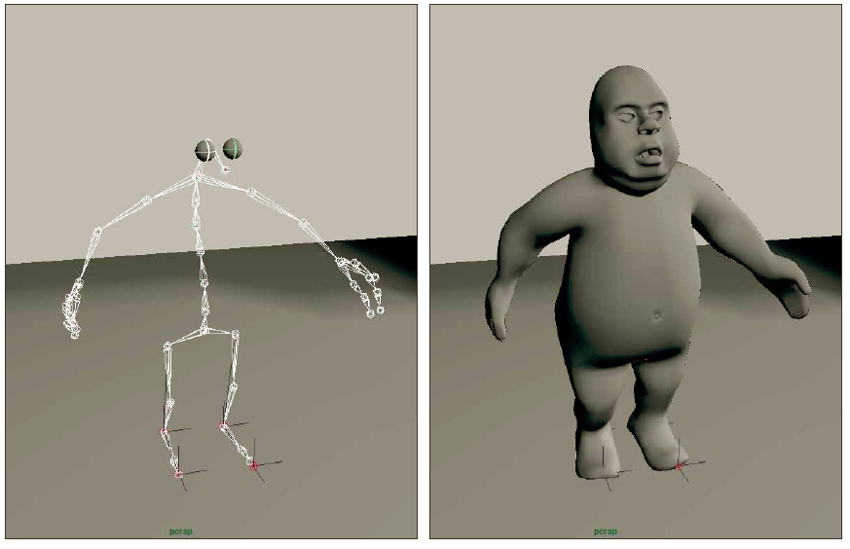

Slide 10
Robot control
Motion Caption
Forward Kinematics
Inverse Kinematics

Slide 11
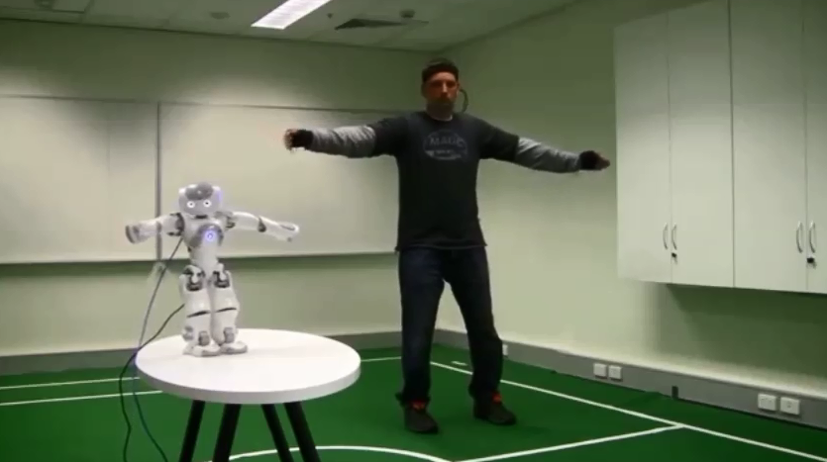
Robot control using Motion Caption

Slide 12
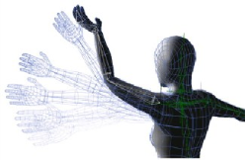
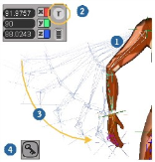
Forward kinematics
The essential concept of forward kinematic animation is that the positions of particular parts of the model at a specified time are calculated from the position and orientation of the object, together with any information on the joints of an articulated model.
So for example if the object to be animated is an arm with the shoulder remaining at a fixed location, the location of the tip of the thumb would be calculated from the angles of the shoulder, elbow, wrist, thumb and knuckle joints.

Slide 13

Forward kinematics

Slide 14
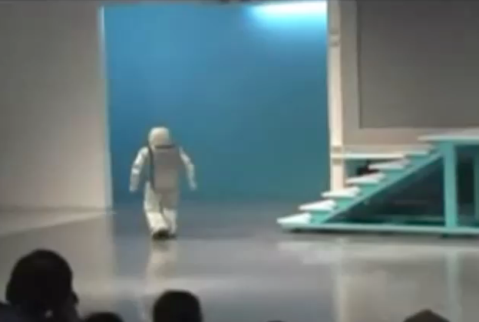
Forward kinematics
Avantage:
  very precise control
Disadvantage:
  difficult for complex movements, for example: climbing stairs

Slide 15
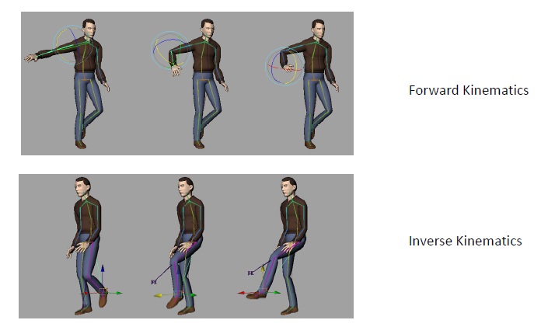

Slide 16
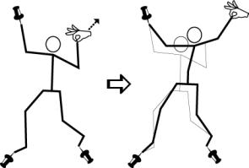
Inverse kinematics
The kinematics equations of the figure define the relationship between the joint angles of the figure and its pose or configuration.
In inverse kinematics the orientation of articulated parts is calculated from the desired position of certain points on the model.
We move only the end effector, and the program calculates the kinematic path of each bones.

Slide 17
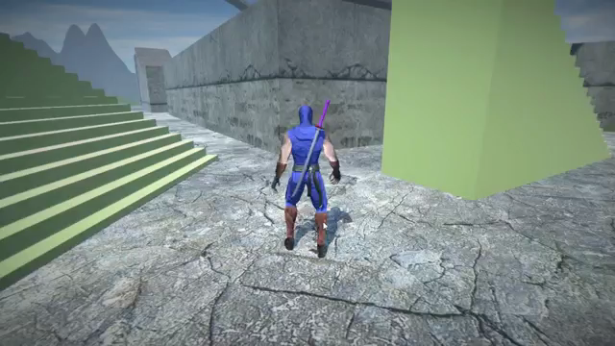
Climbing stairs – IK

Slide 18
Solutions
Jacobian matrix
Cyclic Coordinate Descent (CCD)
Constraint Relaxation (CR)

Slide 19
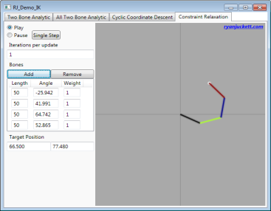
CCD and CR
The attached software compares
the CCD and CR algorithms to a
specified number of bones.
The bone / joint system is
continuous.
There are no rotation restrictions.
The length of the bones can not change, so we only seem to extend the bones in the CR.
Notes:
Program: 3DOFArm, 6DOFArm

Slide 20
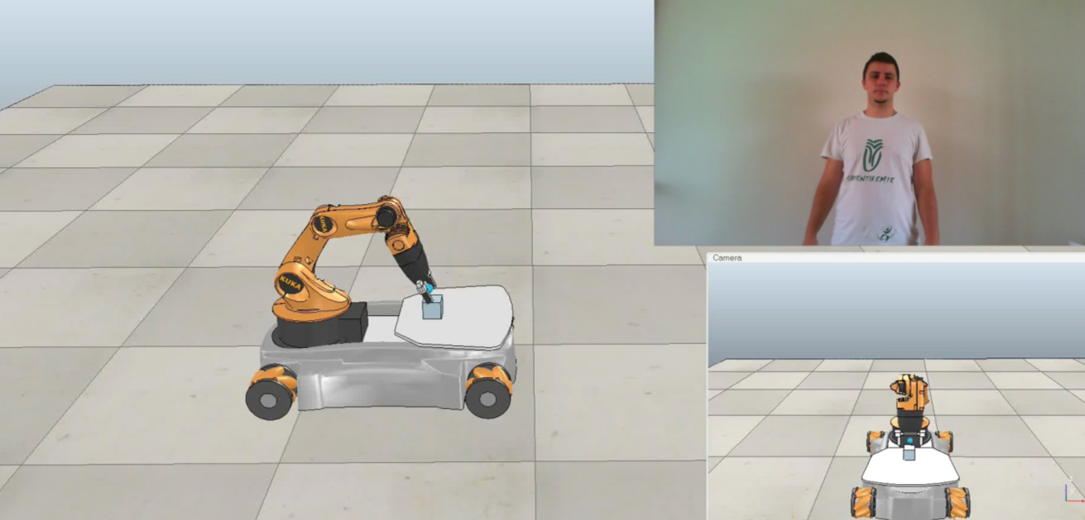
Kinect and robot control

Slide 21
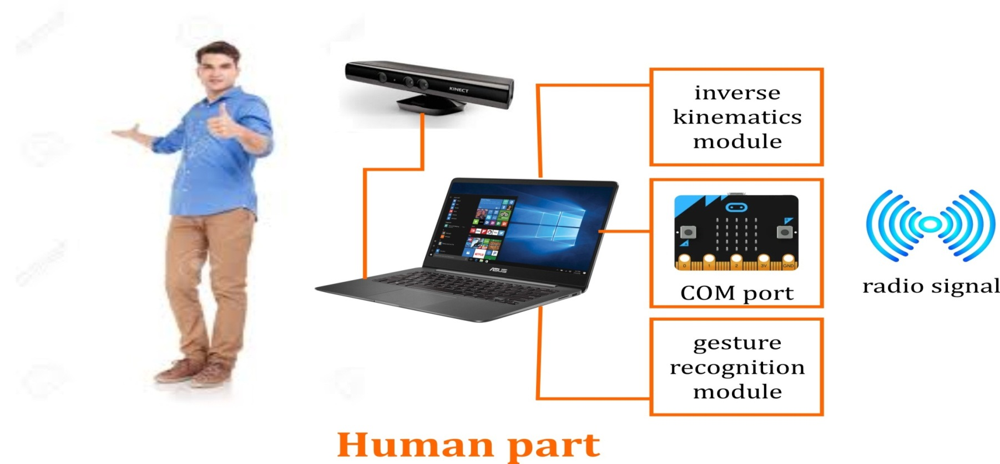
BBC micro:bit

Slide 22
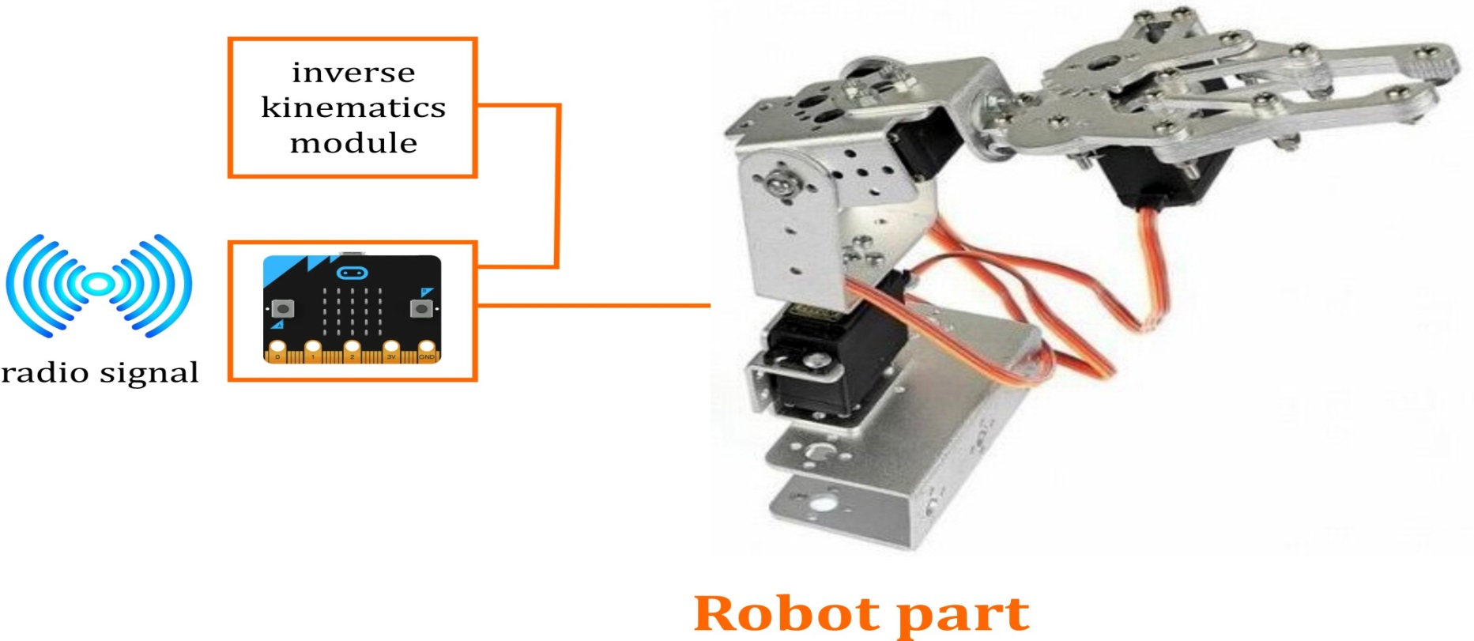
BBC micro:bit

Slide 23
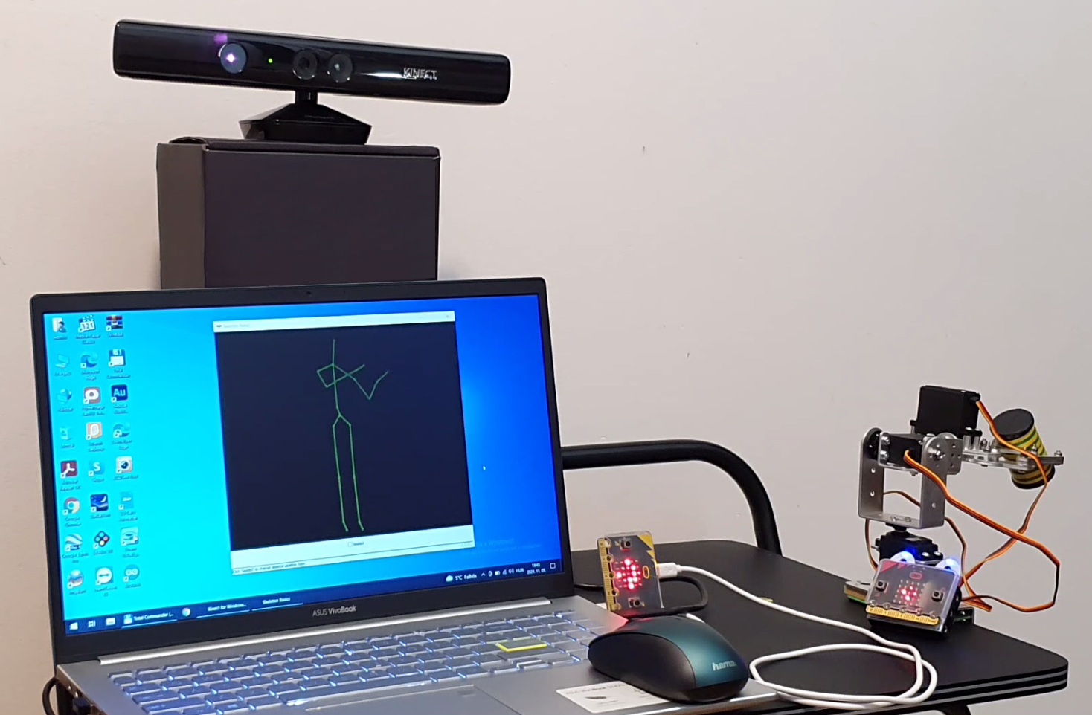
The robot…

Slide 24
IK – Inverse Kinematics (details)

Slide 25
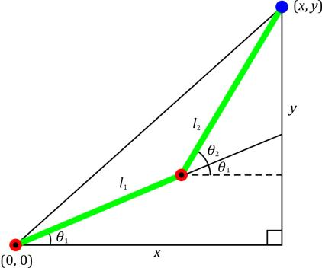
The Analytical Solution
The Problem:
  It is given two bones. The first one have one end in the origin (0, 0) and the second bone starts at the other end.
  With what kind of angles do you need to rotate the two bones so that the free end of the second bone reaches a given position (x, y)?

Slide 26
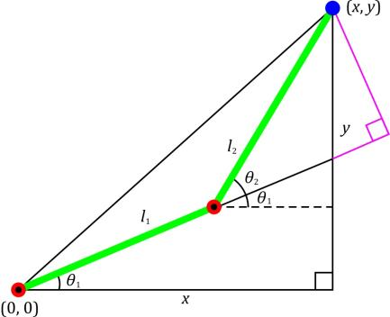
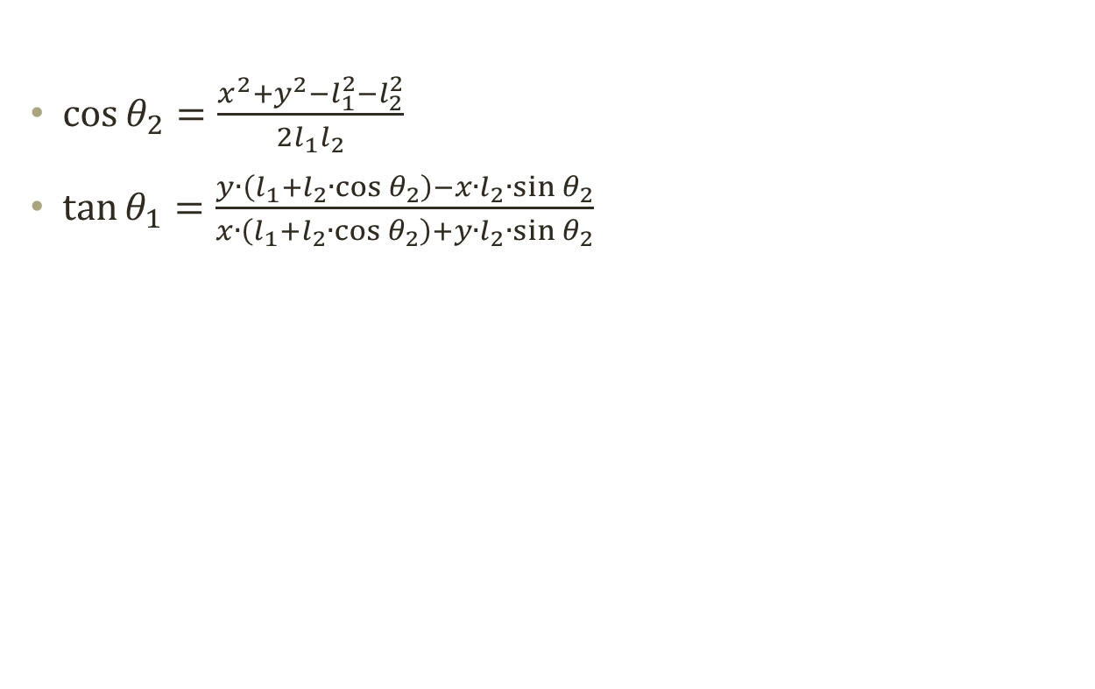
The Solution
$\cos{θ_{2}=\frac{x^{2}+y^{2}−l_{1}^{2}−l_{2}^{2}}{2l_{1}l_{2}}}$
$\tan{θ_{1}=\frac{y∙\left(l_{1}+l_{2}∙\cos{θ_{2}}\right)−x∙l_{2}∙\sin{θ_{2}}}{x∙\left(l_{1}+l_{2}∙\cos{θ_{2}}\right)+y∙l_{2}∙\sin{θ_{2}}}}$

Slide 27
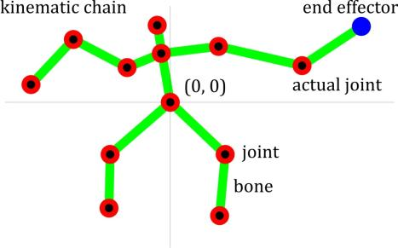
Hierarchical movement
Bone/joint system.
Iterative solution – the analytical solution is very complex.
We are iterating from the end effector to the base and optimizing each joint so that the last one comes close as possible to the target.
The same solution for more inverse kinematics problem.
They are expensive.

Slide 28
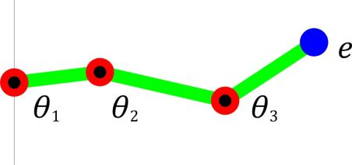
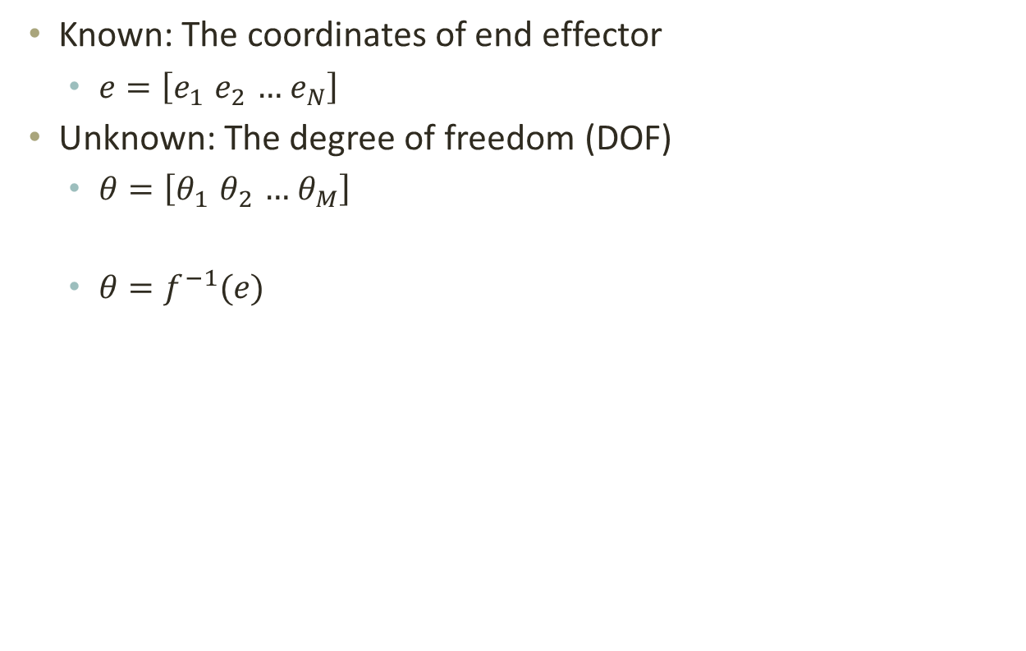
The problem
Known: The coordinates of end effector
  $e=\left[e_{1}{ e}_{2} …{ e}_{N}\right]$
Unknown: The degree of freedom (DOF)
  $θ=\left[θ_{1}{ θ}_{2} …{ θ}_{M}\right]$
  $θ=f^{−1}(e)$

Slide 29
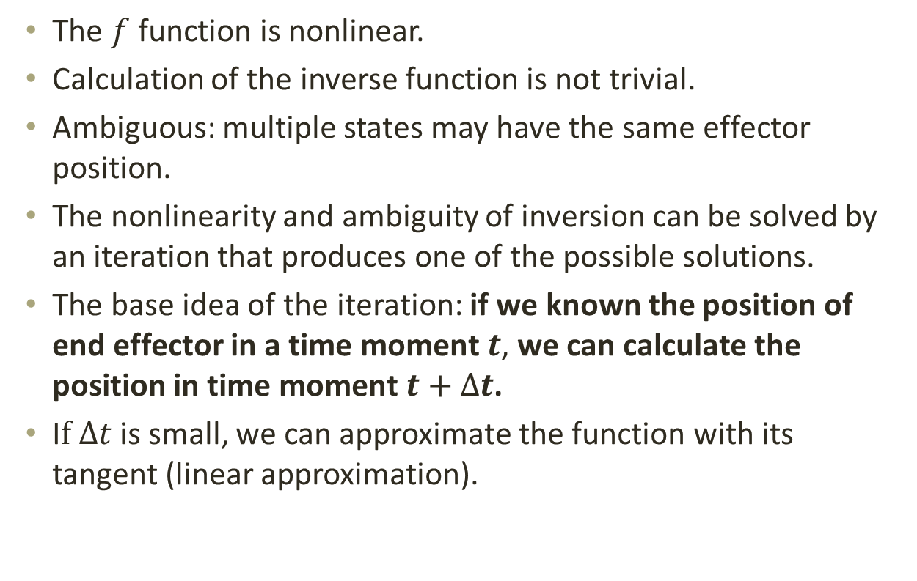
Problems encountered
The $f$ function is nonlinear.
Calculation of the inverse function is not trivial.
Ambiguous: multiple states may have the same effector position.
The nonlinearity and ambiguity of inversion can be solved by an iteration that produces one of the possible solutions.
The base idea of the iteration: if we known the position of end effector in a time moment $t$, we can calculate the position in time moment $t+∆t$.
I$f ∆t$ is small, we can approximate the function with its tangent (linear approximation).

Slide 30
Solutions
Jacobian matrix
Cyclic Coordinate Descent (CCD)
Constraint Relaxation (CR)

Slide 31
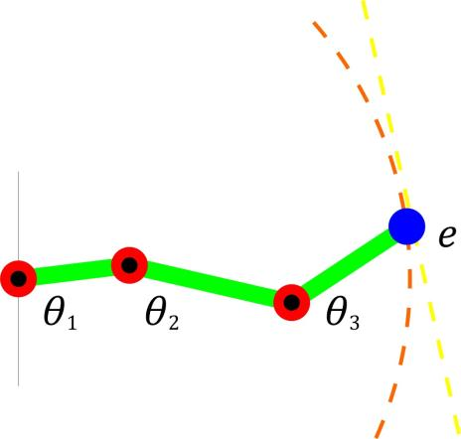
The Jacobian matrix
The linear approximation of function f()

Slide 32
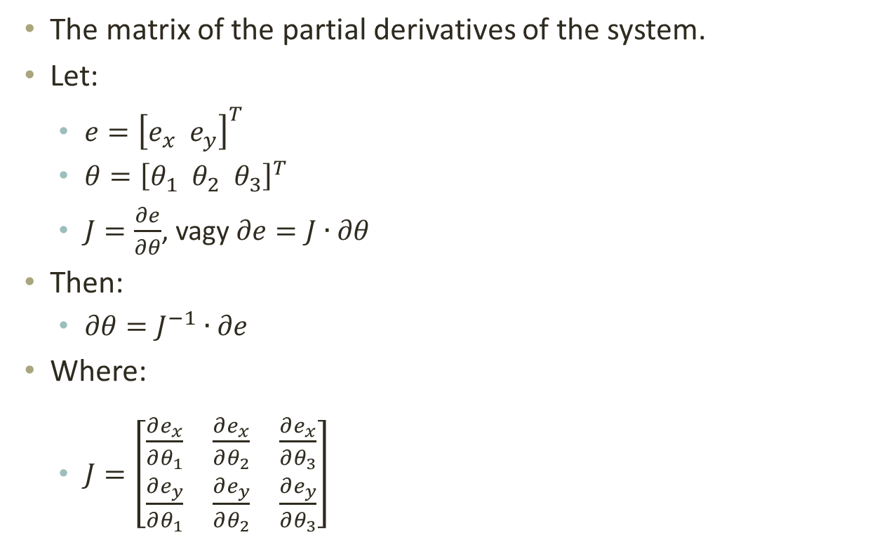
The Jacobian matrix
The matrix of the partial derivatives of the system.
Let:
  $e={\left[e_{x} e_{y}\right]}^{T}$
  $θ={\left[θ_{1} θ_{2} θ_{3}\right]}^{T}$
  $J=\frac{∂e}{∂θ}$, vagy $∂e=J∙∂θ$
Then:
  $∂θ=J^{−1}∙∂e$
Where:
  $J=\left[\begin{matrix}\frac{∂e_{x}}{∂θ_{1}} & \frac{∂e_{x}}{∂θ_{2}} & \frac{∂e_{x}}{∂θ_{3}} \\ \frac{∂e_{y}}{∂θ_{1}} & \frac{∂e_{y}}{∂θ_{2}} & \frac{∂e_{y}}{∂θ_{3}}\end{matrix}\right]$

Slide 33
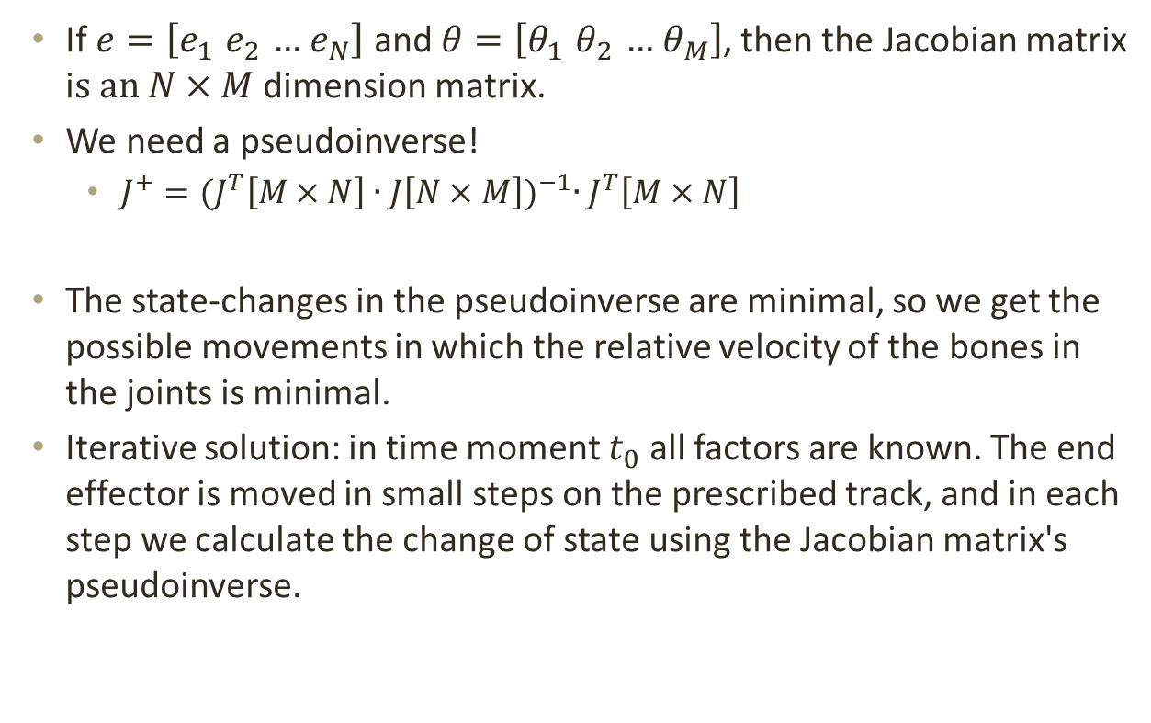
The pseudoinverse
  If $e=\left[e_{1}{ e}_{2} …{ e}_{N}\right]$ and $θ=\left[θ_{1}{ θ}_{2} …{ θ}_{M}\right]$, then the Jacobian matrix i$s an N×M$ dimension matrix.
  We need a pseudoinverse!
    $J^{+}={(J^{T}\left[M×N\right]∙J\left[N×M\right])}^{−1}∙J^{T}\left[M×N\right]$
  The state-changes in the pseudoinverse are minimal, so we get the possible movements in which the relative velocity of the bones in the joints is minimal.
  Iterative solution: in time moment $t_{0}$ all factors are known. The end effector is moved in small steps on the prescribed track, and in each step we calculate the change of state using the Jacobian matrix's pseudoinverse.

Slide 34
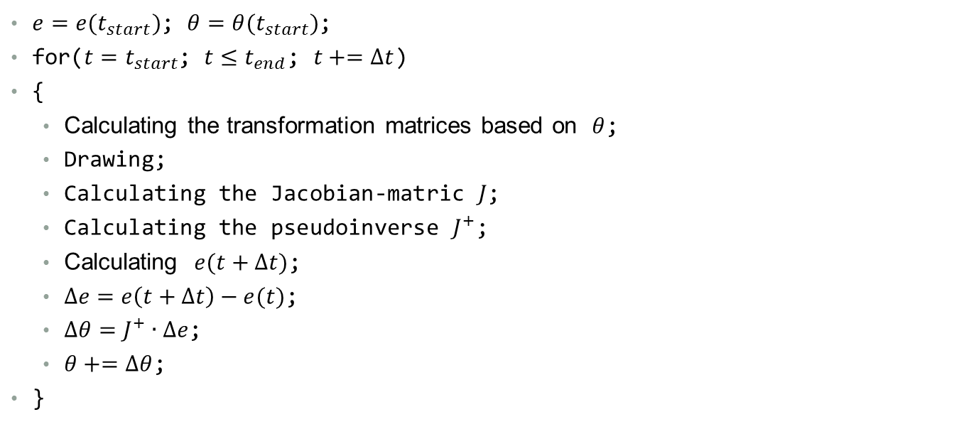
The algorithm
$e=e(t_{start})$; $θ=θ(t_{start})$;
for($t=t_{start}$; $t≤t_{end}$; $t+=∆t$)
{
  Calculating the transformation matrices based on $θ$;
  Drawing;
  Calculating the Jacobian-matric $J$;
  Calculating the pseudoinverse $J^{+}$;
  Calculating $e(t+∆t)$;
  $∆e=$ $e\left(t+∆t\right)−e(t)$;
  $∆θ=J^{+}∙∆e$;
  $θ+=∆θ$;
}

Slide 35
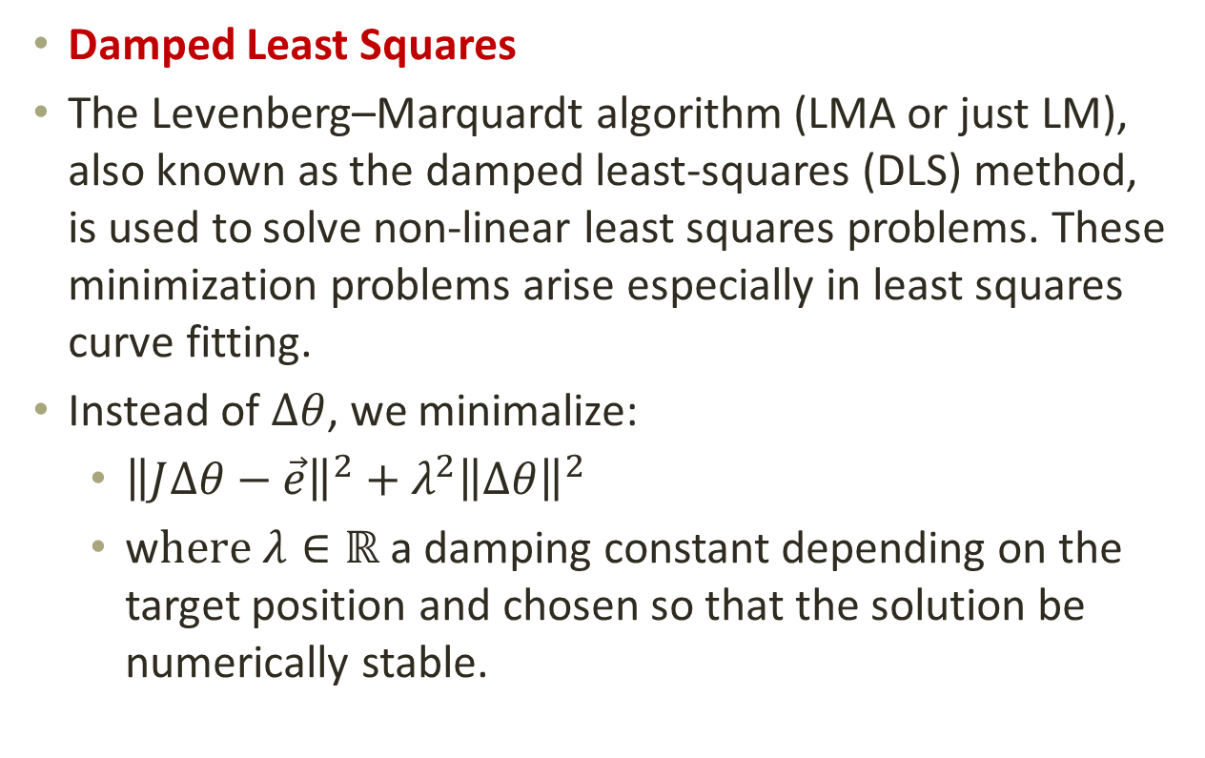
Correction
  Damped Least Squares
  The Levenberg–Marquardt algorithm (LMA or just LM), also known as the damped least-squares (DLS) method, is used to solve non-linear least squares problems. These minimization problems arise especially in least squares curve fitting.
  Instead of $∆θ$, we minimalize:
    ${\left\|J∆θ−\vec{e}\right\|}^{2}+λ^{2}{\left\|Δθ\right\|}^{2}$
    w$here λ∈ℝ$a damping constant depending on the target position and chosen so that the solution be numerically stable.

Slide 36
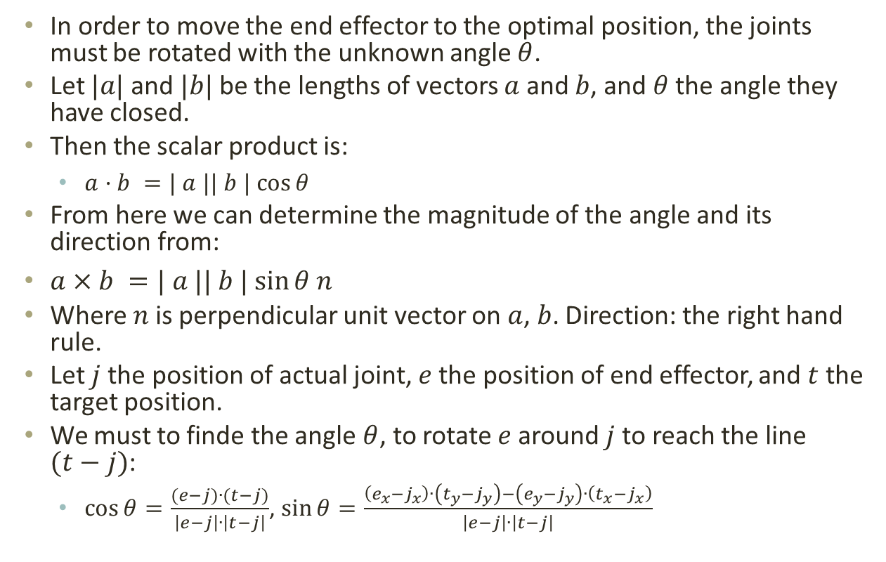
Cyclic Coordinate Descent (CCD)
In order to move the end effector to the optimal position, the joints must be rotated with the unknown angle $θ$.
Let $|a|$ and $|b|$ be the lengths of vectors $a$ and $b$, and $θ$ the angle they have closed.
Then the scalar product is:
  $a·b =| a || b | cos⁡θ$
From here we can determine the magnitude of the angle and its direction from:
$a×b =| a || b | sin⁡θ n$
Where $n$ is perpendicular unit vector on $a$, $b$. Direction: the right hand rule.
Let $j$ the position of actual joint, $e$ the position of end effector, and $t$ the target position.
We must to finde the angle $θ$, to rotate $e$ around $j$ to reach the line $(t−j)$:
  $\cos{θ=\frac{(e−j)∙(t−j)}{\left|e−j\right|∙\left|t−j\right|}}$, $\sin{θ=\frac{\left(e_{x}−j_{x}\right)∙\left(t_{y}−j_{y}\right)−\left(e_{y}−j_{y}\right)∙\left(t_{x}−j_{x}\right)}{\left|e−j\right|∙\left|t−j\right|}}$

Slide 37
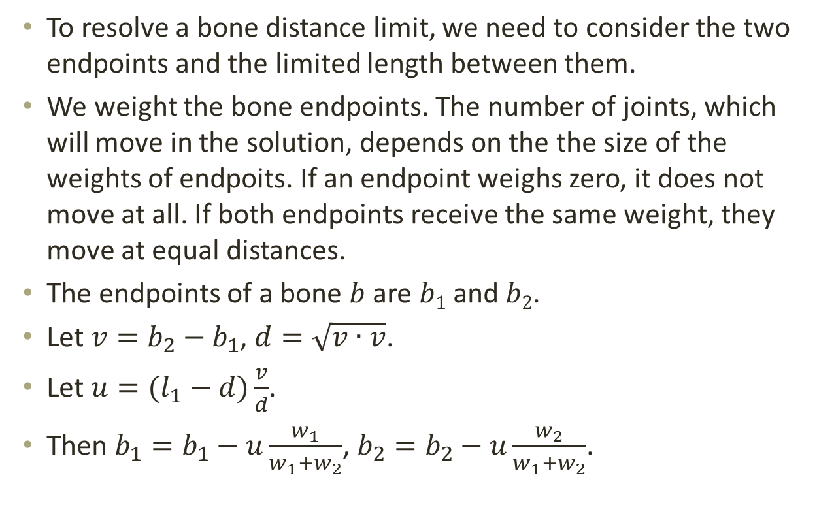
The algorithm
To resolve a bone distance limit, we need to consider the two endpoints and the limited length between them.
We weight the bone endpoints. The number of joints, which will move in the solution, depends on the the size of the weights of endpoits. If an endpoint weighs zero, it does not move at all. If both endpoints receive the same weight, they move at equal distances.
The endpoints of a bone $b$ are $b1$ and $b2$.
Let $v=b_{2}−b_{1}$, $d=\sqrt{v∙v}$.
Let $u=(l_{1}−d)\frac{v}{d}$.
Then $b_{1}=b_{1}−u\frac{w_{1}}{w_{1}+w_{2}}$, $b_{2}=b_{2}−u\frac{w_{2}}{w_{1}+w_{2}}$.

Slide 38
Constraint Relaxation (CR)
This algorithm is capable to calculate the exact position of any bone in an arbitrary long kinematic chain, and it is easy to implement in larger dimensions.
The kinematic chain of joints without rotational constraints can also be understood as point clouds, with distances between points (definite length bones).
By stretching the bones and solve the distance limits, we focus on solving the system.
The essence of the algorithm is to stretch the bones one by one to the target and then restore the original size to get closer to the solution.
Scaling of vectors.

Slide 39
CCD and CR
The attached software compares
the CCD and CR algorithms to a
specified number of bones.
The bone / joint system is
continuous.
There are no rotation restrictions.
The length of the bones can not change, so we only seem to extend the bones in the CR.

Slide 40
Gesture recognition

Slide 41
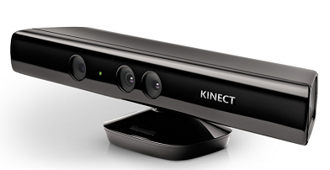
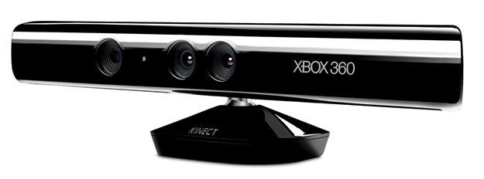
Kinect

Slide 42
Kinect
Kinect (codenamed Project Natal during development) is a line of motion sensing input devices by Microsoft for Xbox 360 and Xbox One video game consoles and Microsoft Windows PCs.
Based around a webcam-style add-on peripheral, it enables users to control and interact with their console/computer without the need for a game controller, through a natural user interface using gestures and spoken commands.
The skeletal mapping technology shown in 2009 was capable of simultaneously tracking four people, with a feature extraction of 48 skeletal points on a human body at 30 Hz.

Slide 43
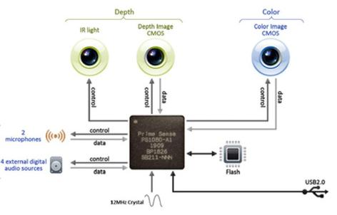

Slide 44
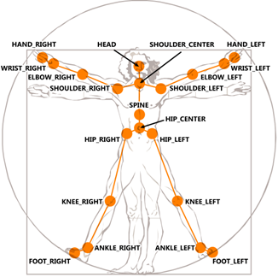
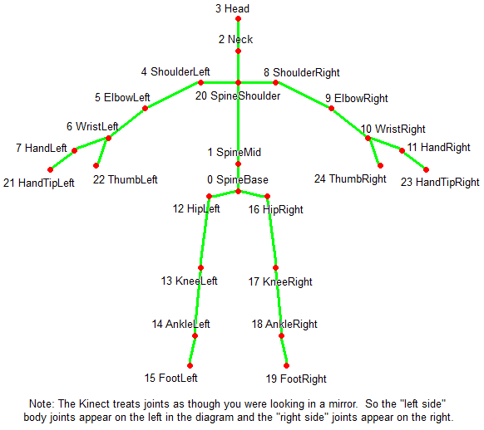

Slide 45
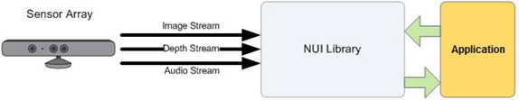

Slide 46
Data Structure – Kinect
point cloud
in space, joints
Vector4 skeletonPosition[NUI_SKELETON_POSITION_COUNT];
void getSkeletalData()
{
NUI_SKELETON_FRAME skeletonFrame = {0};
if (sensor->NuiSkeletonGetNextFrame(0, &skeletonFrame) >= 0)
{
sensor->NuiTransformSmooth(&skeletonFrame, NULL);
for (int z = 0; z < NUI_SKELETON_COUNT; ++z)
{
const NUI_SKELETON_DATA& skeleton = skeletonFrame.SkeletonData[z];
if (skeleton.eTrackingState == NUI_SKELETON_TRACKED)
{
for (int i = 0; i < NUI_SKELETON_POSITION_COUNT; ++i)
{
skeletonPosition[i] = skeleton.SkeletonPositions[i];
if (skeleton.eSkeletonPositionTrackingState[i] ==
NUI_SKELETON_POSITION_NOT_TRACKED)
skeletonPosition[i].w = 0;
}
return;
}
}
}
}

Slide 47
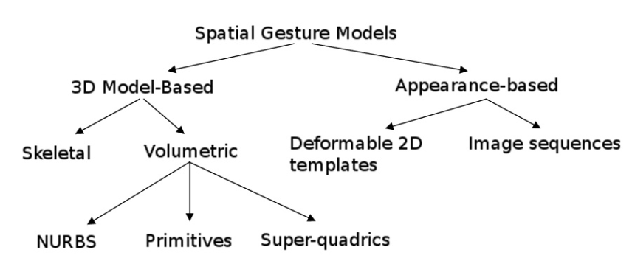
Gesture recognition
Gesture recognition is a topic in computer science and language technology with the goal of interpreting human gestures via mathematical algorithms.

Slide 48
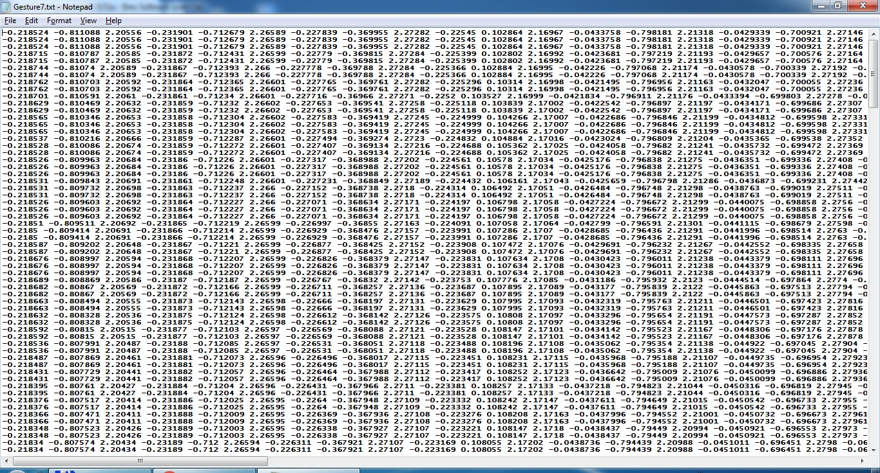
Gesture data

Slide 49
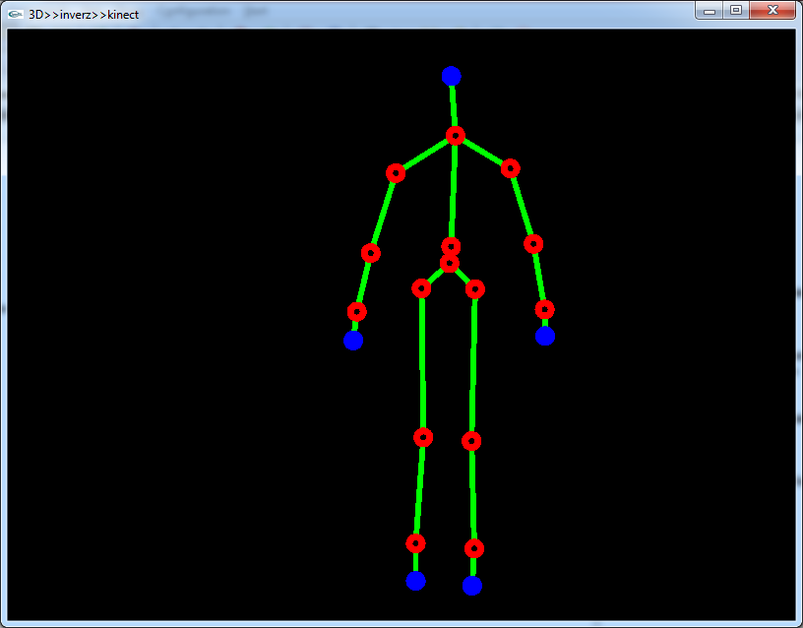
Gesture

Slide 50
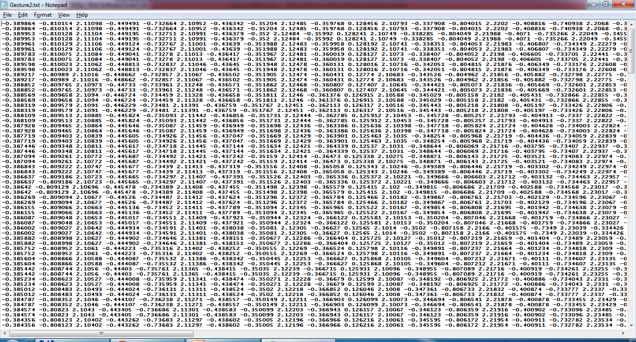
Gesture data

Slide 51
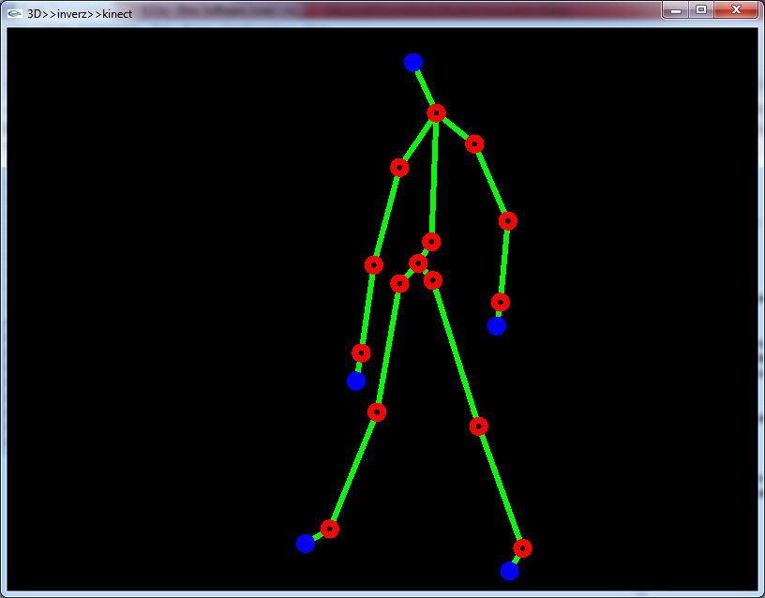
Gesture

Slide 52
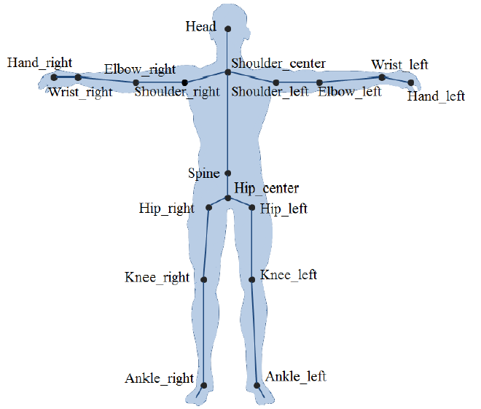
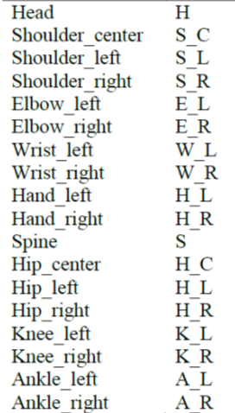
Joints

Slide 53
The Algorithm
DTW - In time series analysis, dynamic time warping (DTW) is one of the algorithms for measuring similarity between two temporal sequences, which may vary in speed.
For instance, similarities in walking could be detected using DTW, even if one person was walking faster than the other.
int DTWDistance(s: array [1..n], t: array [1..m]) {
DTW := array [0..n, 0..m]
for i := 1 to n
for j := 1 to m
DTW[i, j] := infinity
DTW[0, 0] := 0
for i := 1 to n
for j := 1 to m
cost := d(s[i], t[j])
DTW[i, j] := cost + minimum(DTW[i-1, j ], // insertion
DTW[i , j-1], // deletion
DTW[i-1, j-1]) // match
return DTW[n, m]
}

Slide 54
The Algorithm
The proposed algorithm for gesture recognition involves 4 steps:
1) detection of the human user,
2) extraction of the features,
3) a stage of warping, in which the gestures are compared to reference gestures,
4) gesture recognition.
1) Human detection is facilitated by the Kinect sensor.
2) The most important feature of a gesture is limb movement.
3) DTW-algorithm
4) gesture recognition

Slide 55
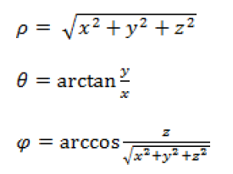
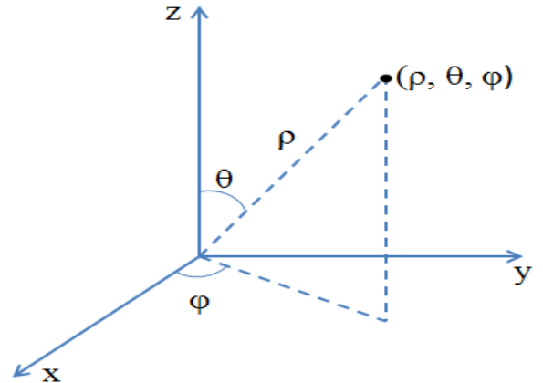
The Algorithm
Each gesture is represented by 33 frames.
Spherical coordinates.
Coordinates are easier to normalize.
Regardless of the size of the user, only the distance from the origin will vary, instead all the coordinates in the Cartesian system and the angles will remain constant.

Slide 56
The Algorithm
detection of the human user
extraction of the features
DTW-warping
gesture recognition
if YES
robot action
learning a new task

Slide 57
Gesture recognition
Video sequence
Geting the joint coordinates
Convert to spherical coordinates
DTW-algorithm
Convert to normal coordinates
Building the vector of features

Slide 58
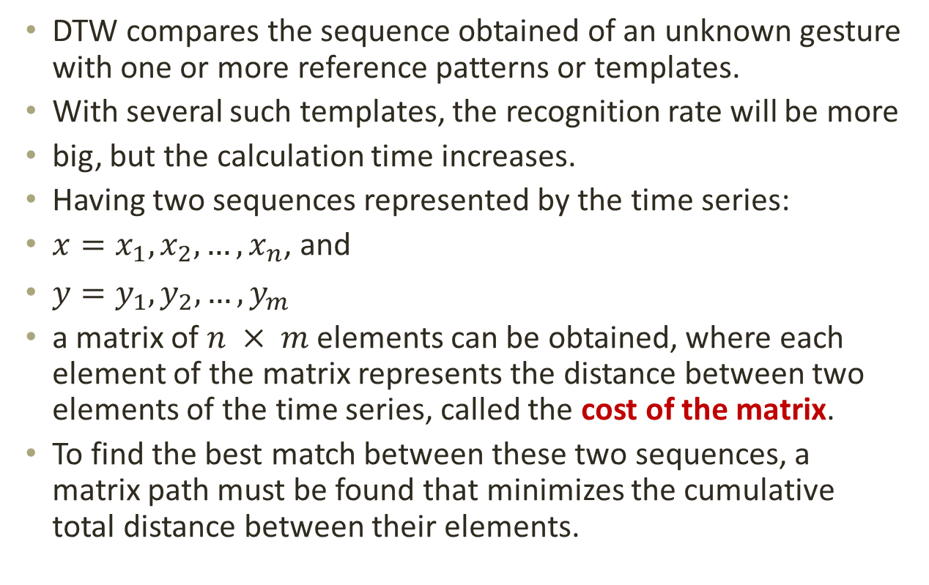
DTW-algorithm
DTW compares the sequence obtained of an unknown gesture with one or more reference patterns or templates.
With several such templates, the recognition rate will be more
big, but the calculation time increases.
Having two sequences represented by the time series:
$x=x_{1},x_{2},…,x_{n}$, and
$y=y_{1},y_{2},…,y_{m}$
a matrix of $n × m$elements can be obtained, where each element of the matrix represents the distance between two elements of the time series, called the cost of the matrix.
To find the best match between these two sequences, a matrix path must be found that minimizes the cumulative total distance between their elements.

Slide 59
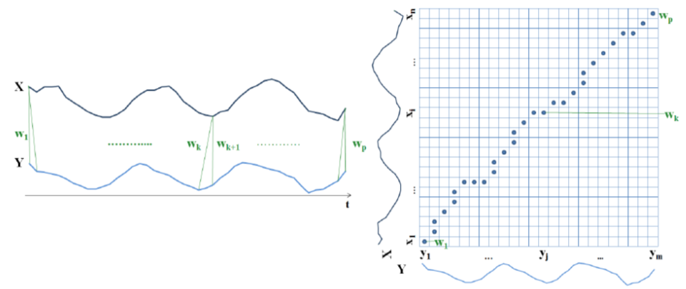
DTW-algorithm
DTW and the warping path

Slide 60

Warping path
Warping path – defines the mapping between the elements of the two time series:
$w=w_{1},w_{2},…,w_{k},…,w_{p}$, where
$DTW\left(x,y\right)=min\sum_{k=1}^{p}{d(w_{k})}$, and
$d(w_{k})$ represents the distance between elements $x_{i}$ and $y_{j}$of the time series, that is:
$d(x_{i}, y_{j}) = | x_{i} –y_{j} |$.

Slide 61
Bibliography
http://www.mogi.bme.hu/TAMOP/robotmechanizmusok/book.html
http://www.euclideanspace.com/maths/algebra/realNormedAlgebra/complex/transforms/
http://www.ryanjuckett.com/programming/analytic-two-bone-ik-in-2d/
http://www.ryanjuckett.com/programming/cyclic-coordinate-descent-in-2d/
http://moddb.wikia.com/wiki/OpenGL:Tutorials:Basic_Bones_System
http://apcmag.com/lets-get-physical-explaining-how-kinect-for-xbox-works.htm/
http://www.contentmaster.com/kinect/kinect-sdk-skeleton-tracking/
https://software.intel.com/en-us/articles/character-animation-skeletons-and-inverse-kinematics
Ing. Răzvan Gabriel I. S. BOBOC: Natural human-robot interaction
for assistive robotics applications, PhD thesis, Brașov, 2015.
Szirmay-Kalos L., Antal Gy., Csonka F.: Háromdimenziós grafika, animáció és játékfejlesztés, ComputerBooks, Budapest, 2006.
Juhász Imre: OpenGL, jegyzet, Miskolc, 2003.
Kovács D. Lehel István: Számítógépes grafika, Scientia Kiadó, 2009.
Samuel R. Buss: Introduction to Inverse Kinematics with Jacobian Transpose, Pseudoinverse and Damped Least Squares methods, University of California, San Diego, 2009.
Stephen J. Wright: Coordinate Descent Algorithms, University of Wisconsin, 2010.

Slide 62
Exam – Project

Slide 63
Project
Group project: 3–5 students in a group.
You don't need a device, you have to implement it on the simulator (makecode).
I am interested in the algorithm and the program.
The HEX file and a short description must be sent by email: klehel77@yahoo.com
Deadline: April 30, 2024.

Slide 64

Project topics
OR 1. OR 2. OR 3. Use your imagination!
1. GAME
Implementation of any simple game on micro:bit.
The display of the micro:bit must be used.
A radio connection can also be used with several micro:bits.
Example: tic-tac-toe (X-O) game on two micro:bits.

Slide 65

2. CuteBot SUMO
Two cutebots in one boxing ring.
They must not leave the ring.
They look for each other.
Attack (offensive) strategy.
Defense strategy.

Slide 66

3. Green wave in traffic
The "green wave" in traffic is a concept designed to optimize the flow of traffic on roads and allow vehicles to pass through several successive traffic lights continuously.
A micro:bit with an RGB LED = a semaphore.
City map with semaphores.
Radio communication between
micro:bits.
Velocity of cars.
Simulating a couple of cases.

Slide 67
Thank you for your attention!
Questions?

