Slide 1

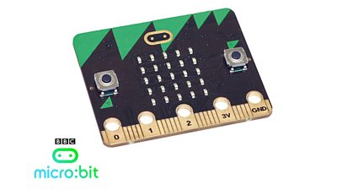
Micro:bit – 02
Lehel István KOVÁCS, PhD.
Sapientia Hungarian
University of Transylvania

Slide 2
5. IoT, smart solutions

Slide 3
Notions
IoT: Internet of Things – describes devices with sensors, processing ability, software and other technologies that connect and exchange data with other devices and systems over the Internet or other communications networks.
Smart solutions, Smart systems: systems which are able to incorporate and perform functions of sensing, actuation, and control in order to analyze a situation, based on acquired data and perform decisions in a predictive or adaptive manner.

Slide 4
Systems
Smart home: A home automation system will monitor and/or control home attributes such as lighting, climate, entertainment systems, and appliances. It may also include home security such as access control and alarm systems.
Smart greenhouse: a revolution in agriculture, creating a self-regulating microclimate (temperature an humidity) suitable for plant growth through the use of sensors, actuators, and monitoring and control systems that optimise growth conditions and automate the growing process.
Smart car: Autonomous car, an automobile capable of driving itself.

Slide 5
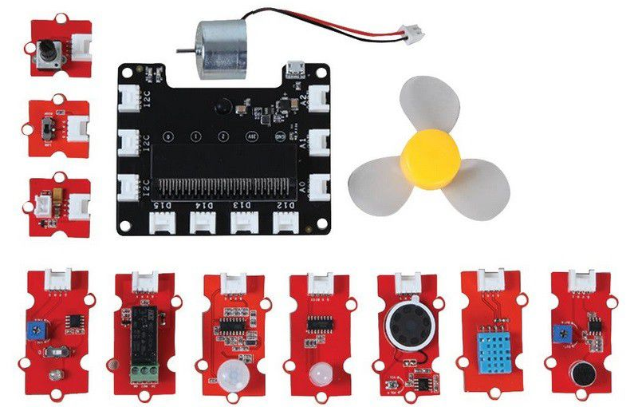
Smart home
Mi:Node kit is a modular, safe and easy to use group of items that allow kids to minimize the effort required to get started with IOT learning with micro:bit:
  Light Sensor
  Temperature and Humidity Sensor
  Sound Sensor
  Rotary Angle
  Mini Fan
  Speaker
  PIR Motion Sensor
  RGB LED
  Switch
  Relay
Notes:
Programok: Tapsra fény (ClapLight), mozgásra hang (PIRSound).

Slide 6
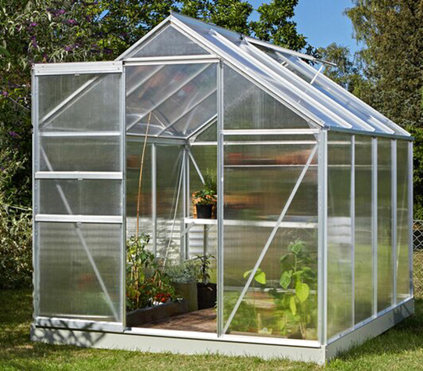
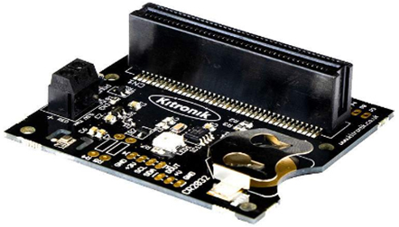
Smart greenhouse
A set of sensors:
  Kitronik RTC & Klimate board
  Temperature sensor
  Barometer
  Hygrometer
  Kitronik Prong Soil Moisture Sensor
  Water pump
  Motorized ball valve
  Water level sensor
  Light sensor
  RGB LED

Slide 7
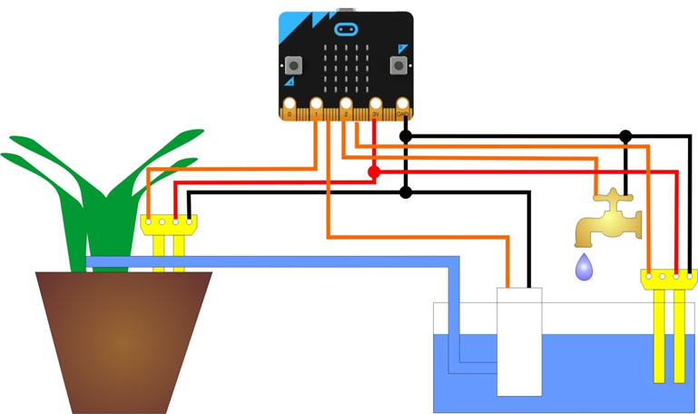
Irrigation equipment

Slide 8
Ventilation and heating system
We measure the internal temperature and humidity of the greenhouse.
If either of the two is higher than the specified thresholds, the micro:bit will start the fan and open the window via the relay using a higher power motor.
If the temperature falls below a given threshold, the electric heater is activated via another relay.
The light sensor measures the light intensity inside the greenhouse and if it falls below a certain threshold, the micro:bit switches on the artificial lighting via the RGB LED.
For optimal photosynthesis to work, experiments have shown that the RGB LED should be lit at R = 220, G = 75, B = 200.
Notes:
Program: sötétségre fény (DarkLight)

Slide 9
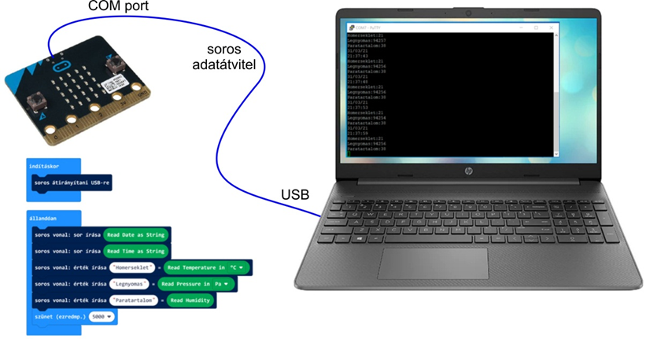
Log

Slide 10
6. Smart cars

Slide 11
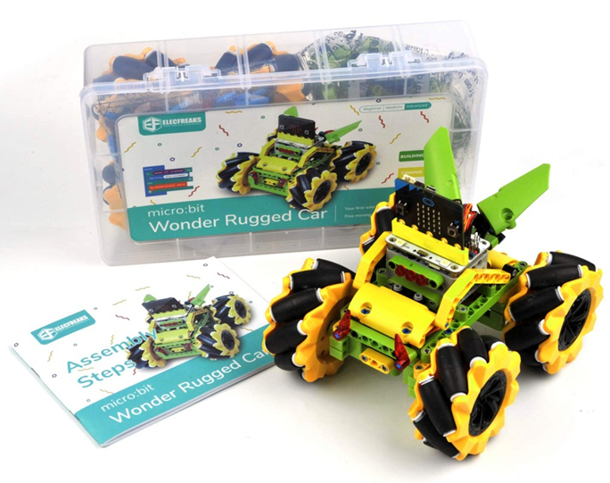
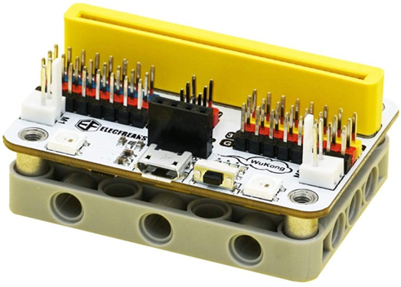
Wonder Rugged Car

Slide 12
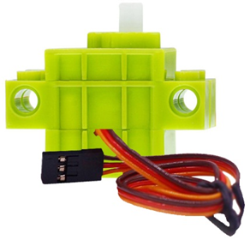
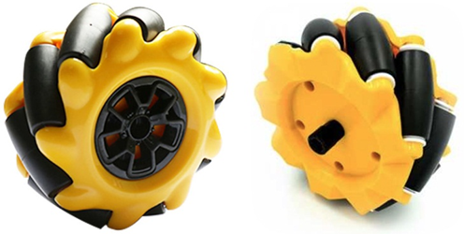
Mecanum wheels

Slide 13
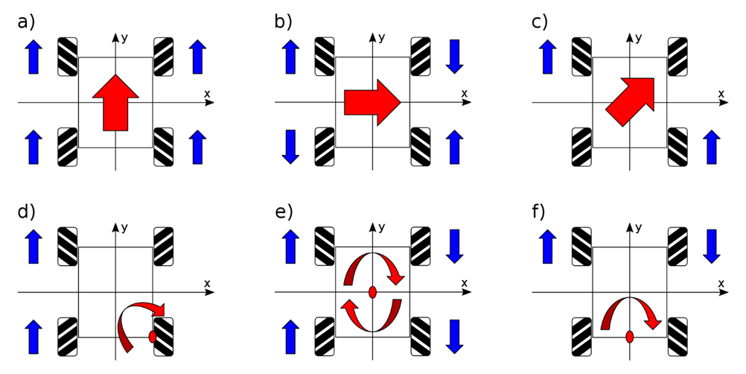
Principle
Notes:
Program: WonderDemo (WonderDemo), Távirányítóval (megírni – Rádió kapcsolat)

Slide 14
7. Cars and sensors

Slide 15
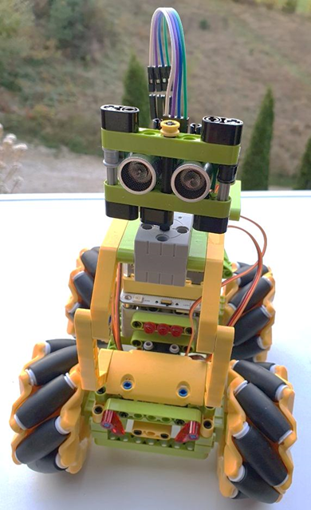
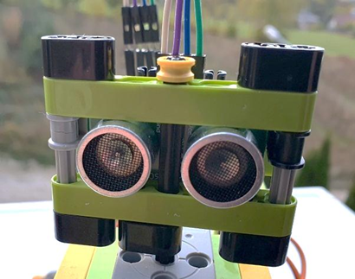
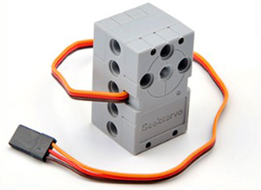

Slide 16
Avoiding obstacles
Our goal was to create a wonder car that detects the obstacles in front of it, stops about 20 cm from them, then checks whether there is a clear path to the left or right, and if so, continues there.

Slide 17
Thank you for your attention!
Questions?

