Slide 1

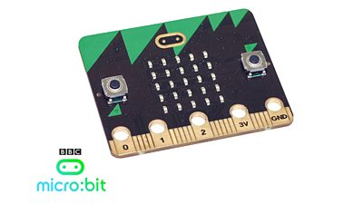
Micro:bit – 01
Lehel István KOVÁCS, PhD.
Sapientia Hungarian
University of Transylvania

Slide 2
1. Micro:bit – introduction, programming with makecode

Slide 3


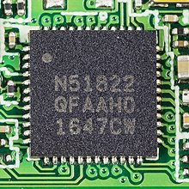
micro:bit
An open source hardware ARM-based embedded system designed by the BBC for use in computer education.
Half the size of a credit card.
ARM Cortex-M0 processor.
Accelerometer and magnetometer sensors.
Temperature and light sensors.
Bluetooth and USB connectivity.
A display consisting of 25 LEDs.
Two programmable buttons.

Slide 4
micro:bit – V1 and V2
V1:
  Nordic nRF51822 – 16 MHz 32-bit ARM Cortex-M0 microcontroller, 256 KB flash memory, 16 KB static RAM, 2.4 GHz Bluetooth low energy wireless networking.
V2:
  Nordic nRF52833 – 64 MHz 32-bit ARM Cortex-M4 microcontroller, 512 KB flash memory, 128 KB static RAM, 2.4 GHz Bluetooth low energy wireless networking.
  +1 button.
  +Knowles MEMS microphone with a built-in LED indicator.
  +Buzzer sound system.

Slide 5
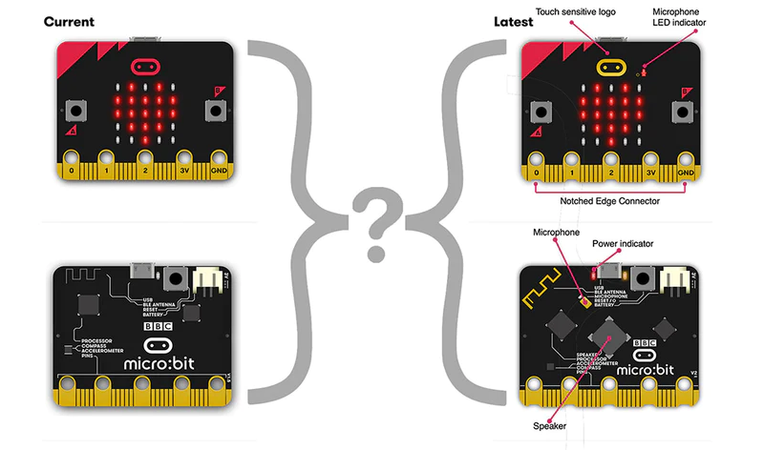

Slide 6
Firmware – Operating system
Hardware is the physical part of a micro:bit.
Software is made up of the programs you write and run on your micro:bit.
Firmware is in the middle: a special kind of software that makes devices function properly. It’s physically stored in the micro:bit’s interface chip and doesn’t change when you write programs or turn your micro:bit off, but it can be updated.
DETAILS.TXT file on the MICROBIT drive: Interface Version: 0249

Slide 7
How to update the firmware
Disconnect the USB cable and battery pack from the micro:bit.
Hold the reset button at the back of the micro:bit and plug the USB lead into the micro:bit and a computer. You should see a drive appear in your file manager called MAINTENANCE (instead of MICROBIT).
Download the .hex file appropriate for your version of the micro:bit from https://microbit.org/get-started/user-guide/firmware/ to your computer. The version number is printed in the bottom right-hand corner on the rear of the device.
Drag and drop the .hex file you downloaded from this page onto the MAINTENANCE drive and wait for the yellow LED on the back of the device to stop flashing. When the upgrade is completed, the micro:bit will reset, ejecting itself from the computer and re-appear in normal MICROBIT drive mode.

Slide 8
Programming
There are three official code editors on the micro:bit foundation web site:
  Microsoft MakeCode (Blocks, JavaScript, Python)
  MicroPython
  Scratch
Other editors for the BBC micro:bit include:
  Mu, a Python editor
  Espruino, a JavaScript interpreter
  EduBlocks, a block editor for MicroPython
Other languages: Free Pascal, Simulink in Matlab, C++, Forth, Lisp, Rust, Ada, Swift, BASIC

Slide 9
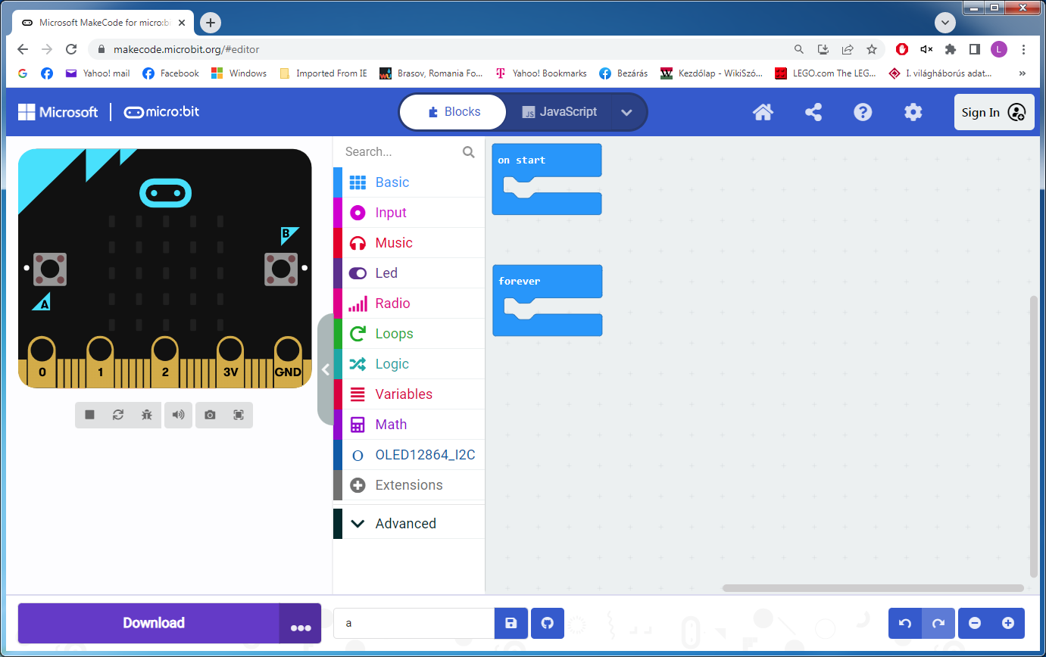
Notes:
- Bemutatni a honlapon. Egyszerű programok, érzékelők kiolvasása, írás.

Slide 10
2. Sensors and motors

Slide 11
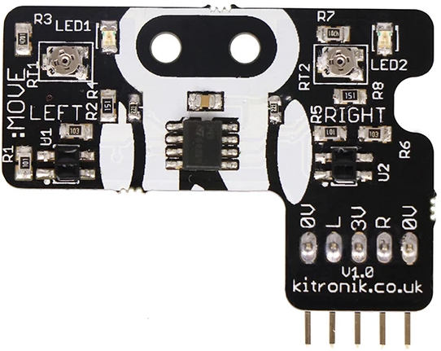
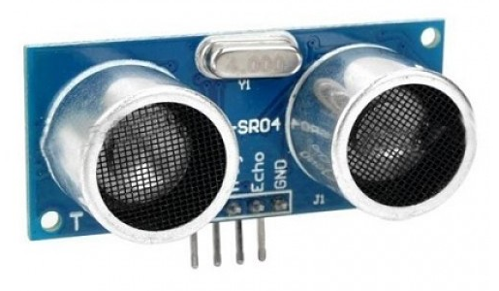
Sensors
Many 3.3V sensors can be connected to the micro:bit.
What we're talking here about:
  Light sensor (not the built-in one)
  Ultrasonic sensor (sonar)

Slide 12
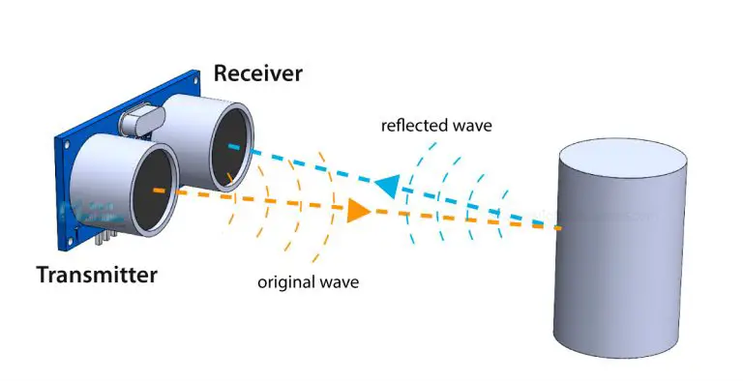
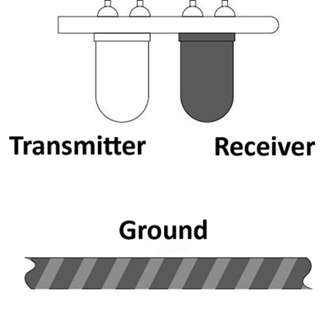
Principle
Time of flight (ToF); Distance = Speed x Time

Slide 13
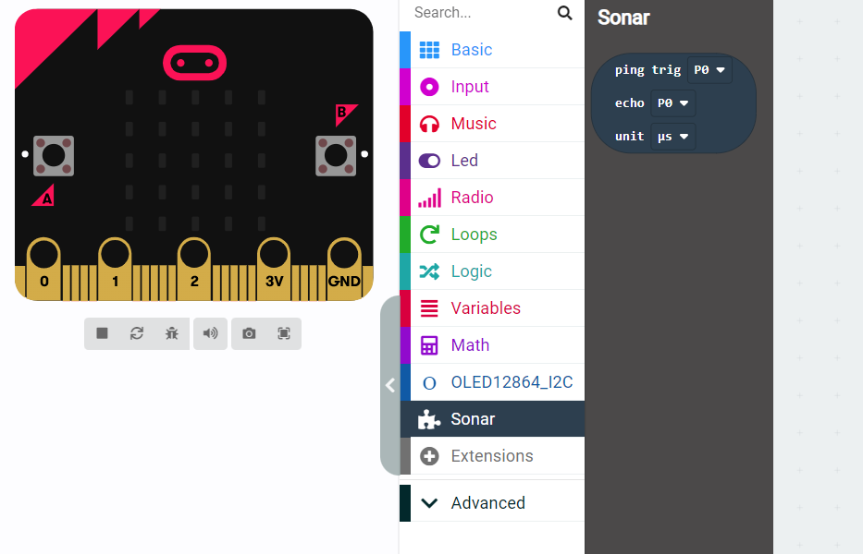
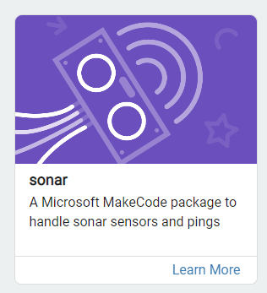
Programming
Extensions
Notes:
Program: Sonar (Sonar).

Slide 14
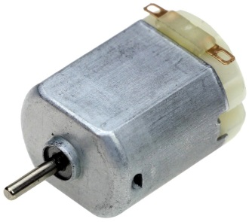
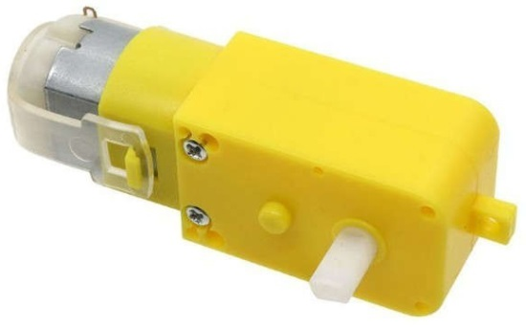
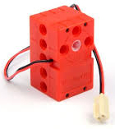
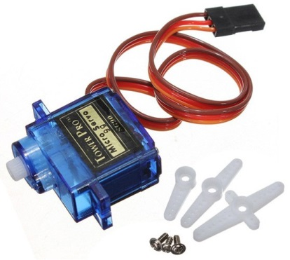
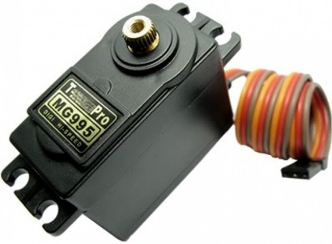
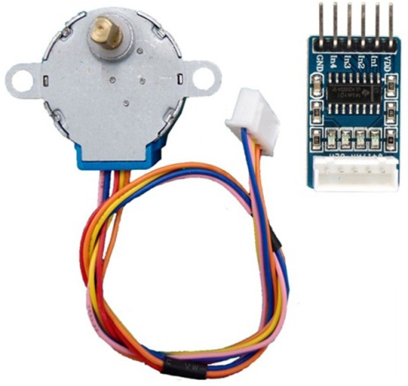
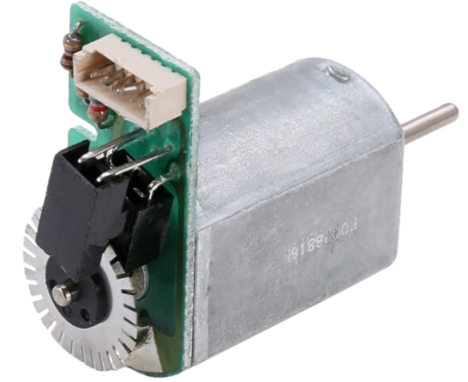
Motors
DC motors
  Without reductor
  With reductor (Gearbox)
Servomotors
  LEGO
  180°
  360°
Stepper-motors
Encoders

Slide 15
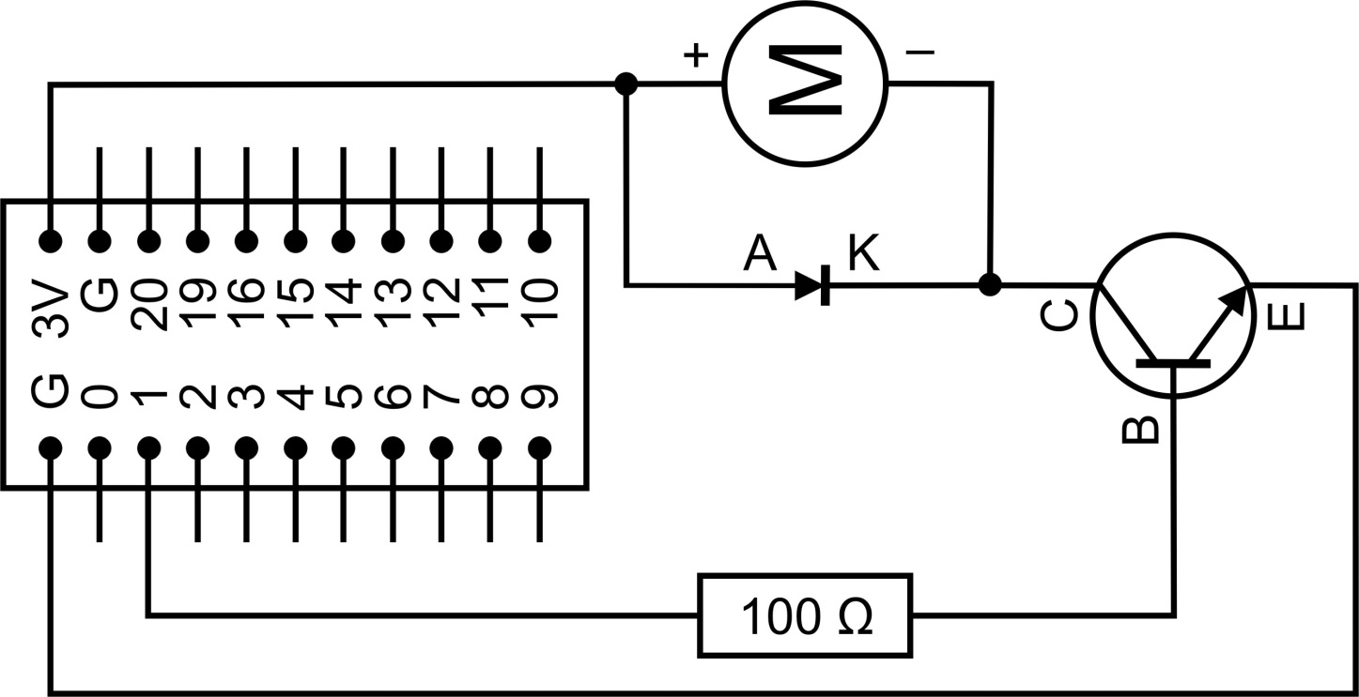

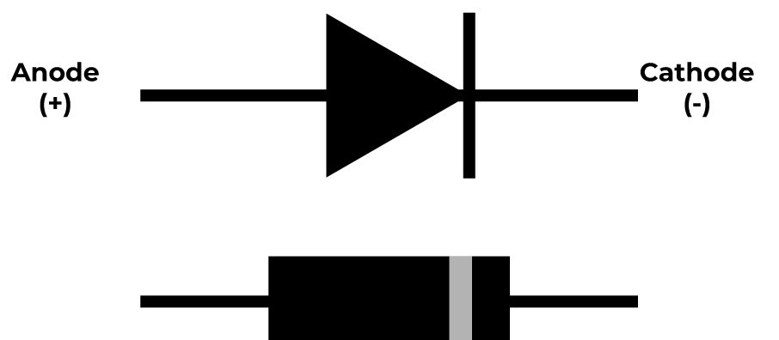
Important!
Always connect the DC motor to the circuit via a diode!
(To avoid backflow!)

Slide 16
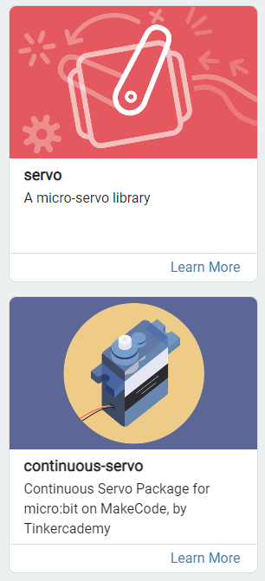
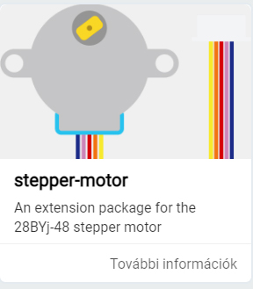
Programming
Extensions
Pins directly
Motor drivers

Slide 17
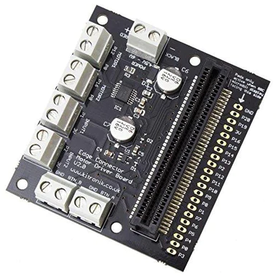
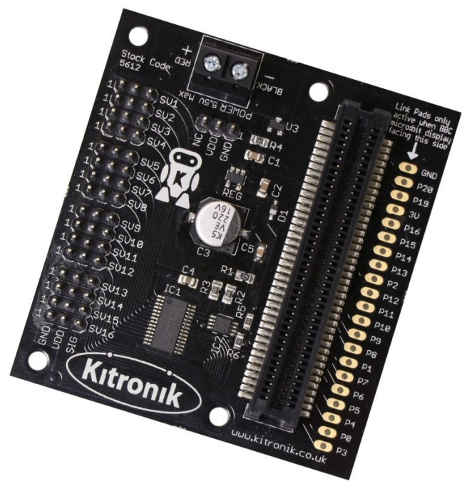
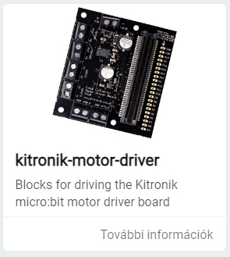
Motor drivers
DC motors
Servomotors

Slide 18
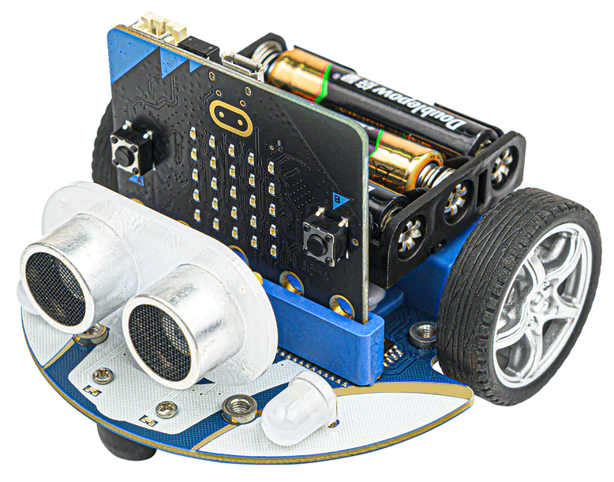
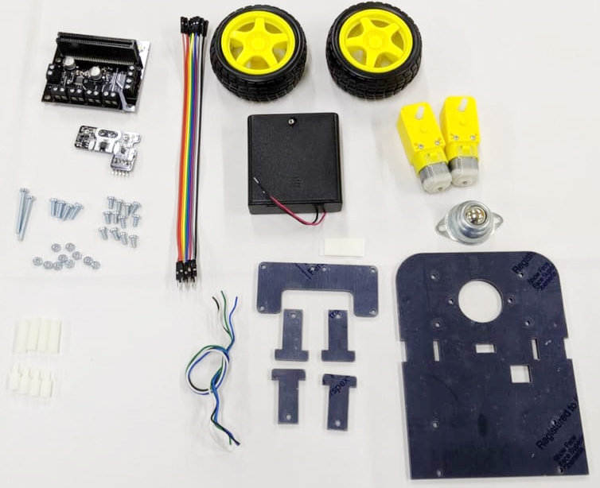
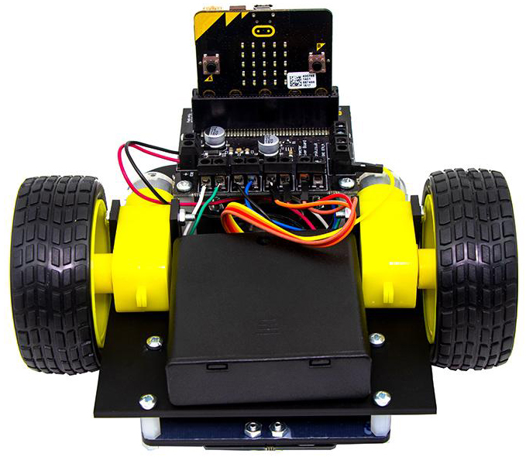
Line followers
Kitronik
Cutebot
Notes:
Program: Kitronik Line Follower (Kitronik-LF).

Slide 19
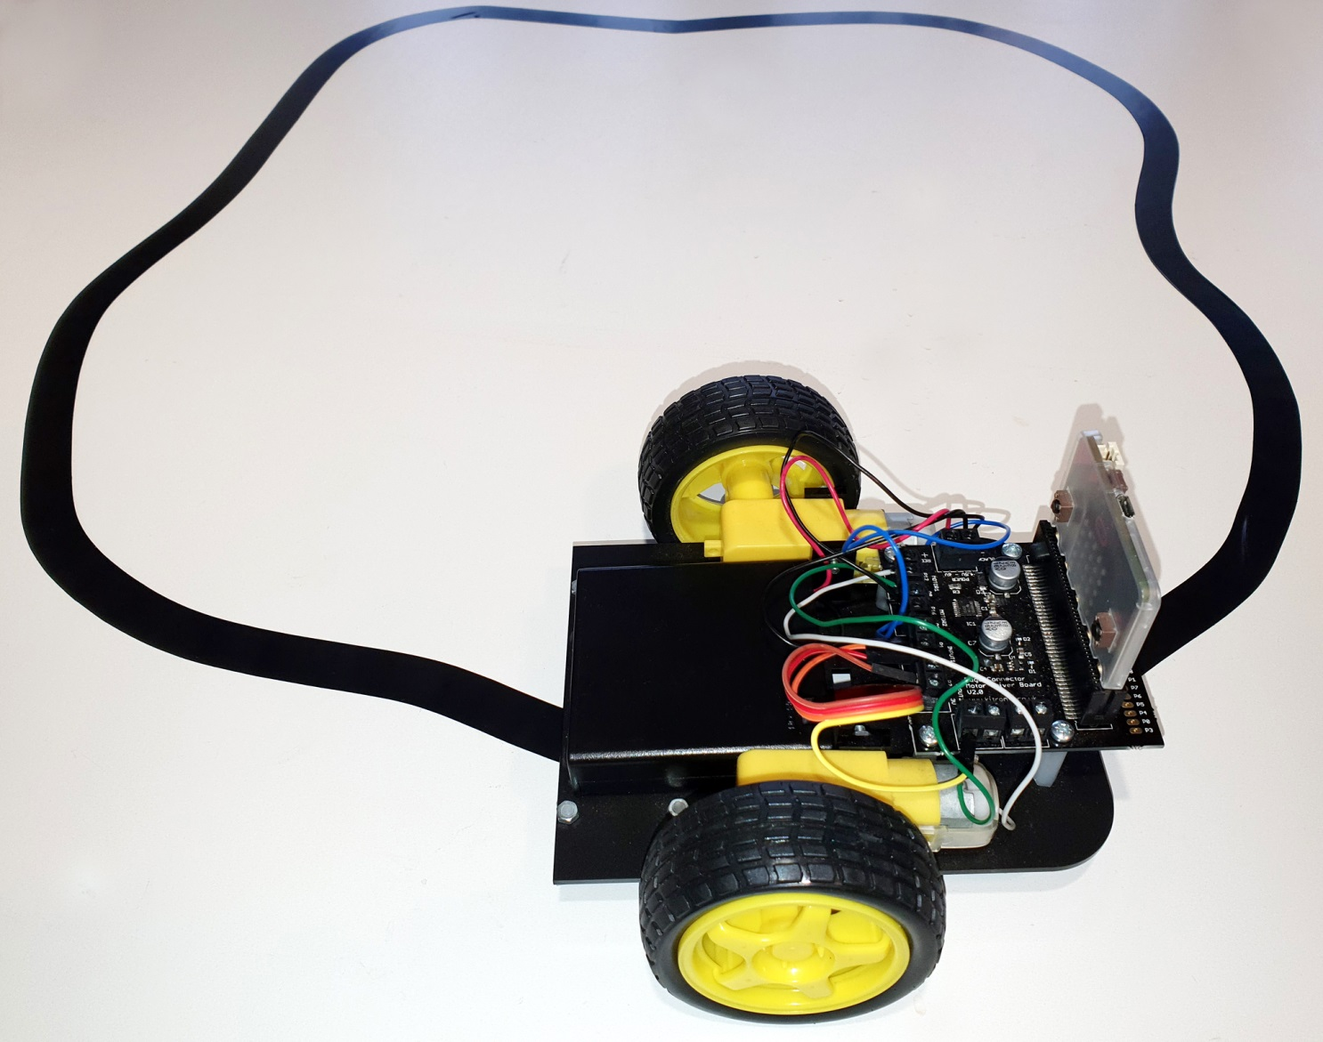
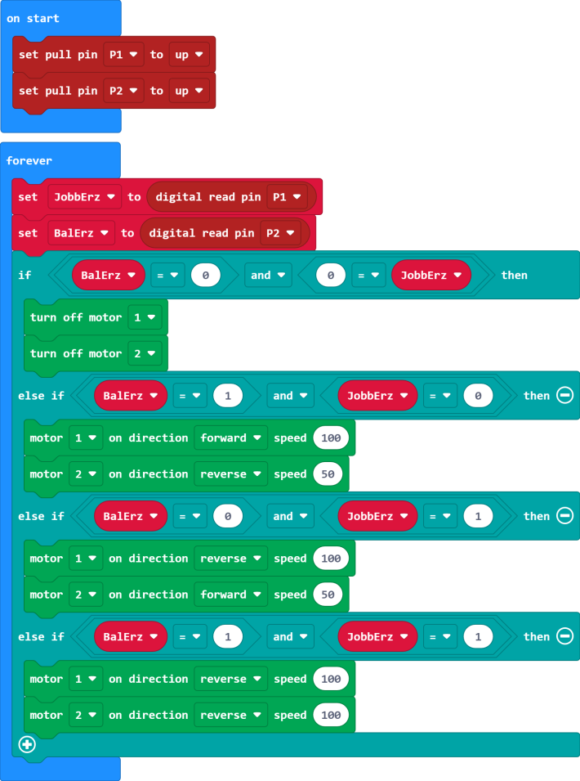

Slide 20
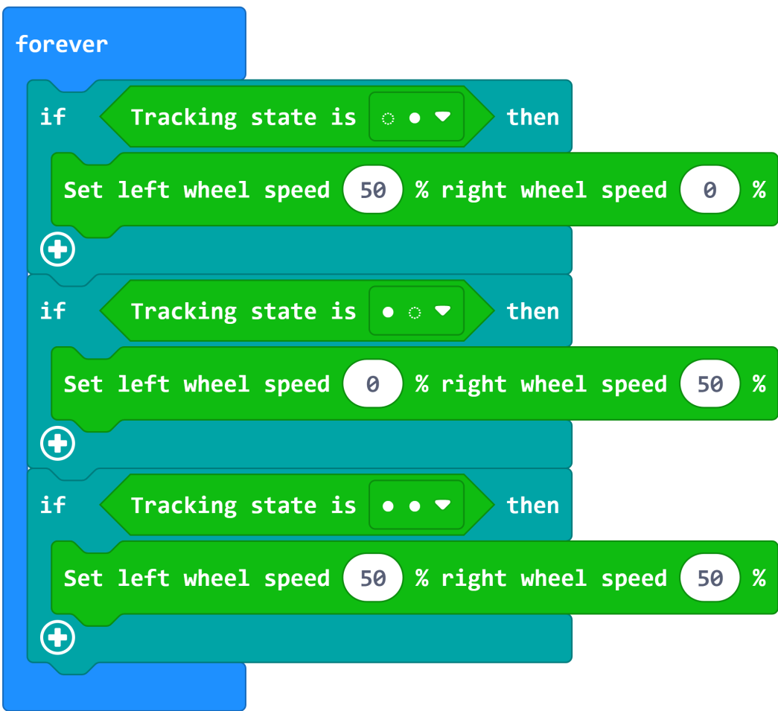
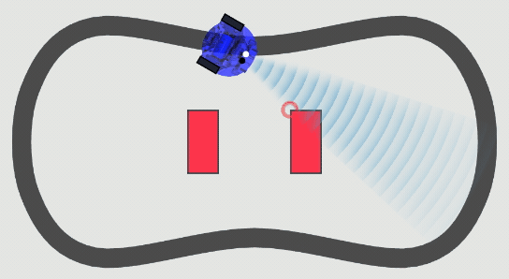
Cutebot program
Cutebot extension
Notes:
Program: Cutebot vonalkövető (Cutebot-LF).

Slide 21
Line and object detection
Line detection – Light sensor (stay inside the ring – change direction when reach the black line)
Object detection – Ultrasonic sensor (change direction when approaching to an object)
Programs
Notes:
Programozzanak, programbemutató

Slide 22
3. Communication channels

Slide 23
Channels
Serial: micro:bit – computer (USB – COM port)
Radio: micro:bit – micro:bit
Bluetooth: micro:bit – micro:bit, computer, phone etc.
OR radio OR bluetooth

Slide 24
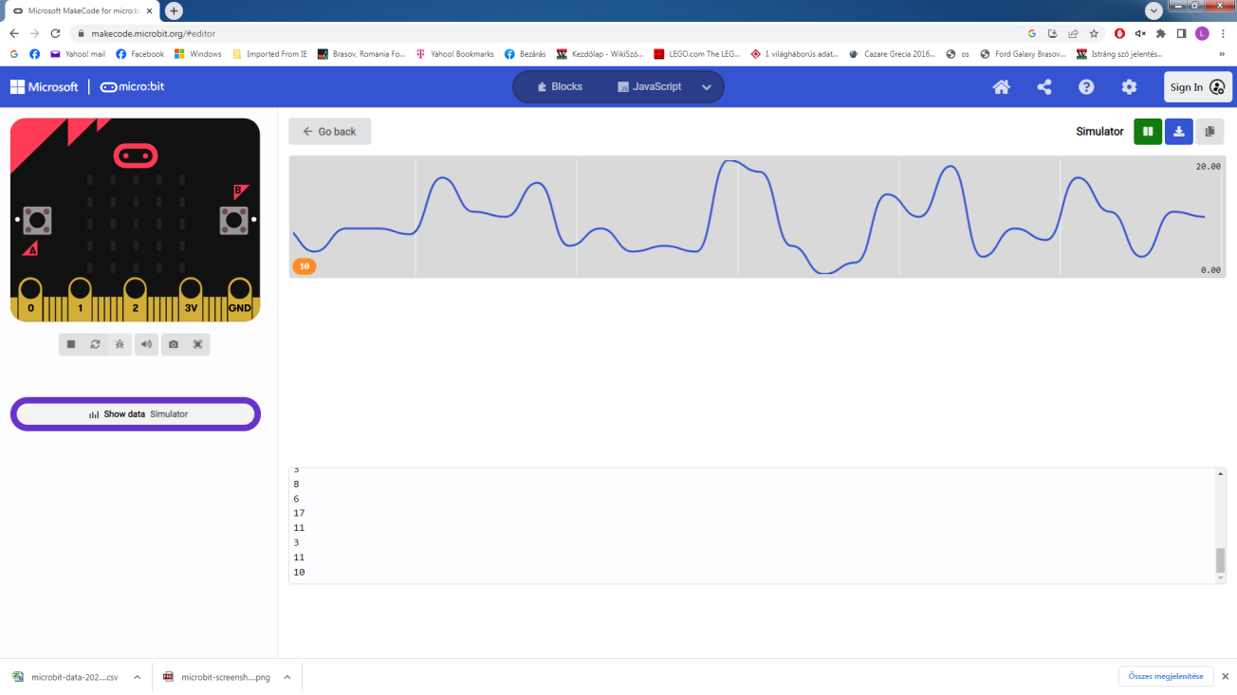
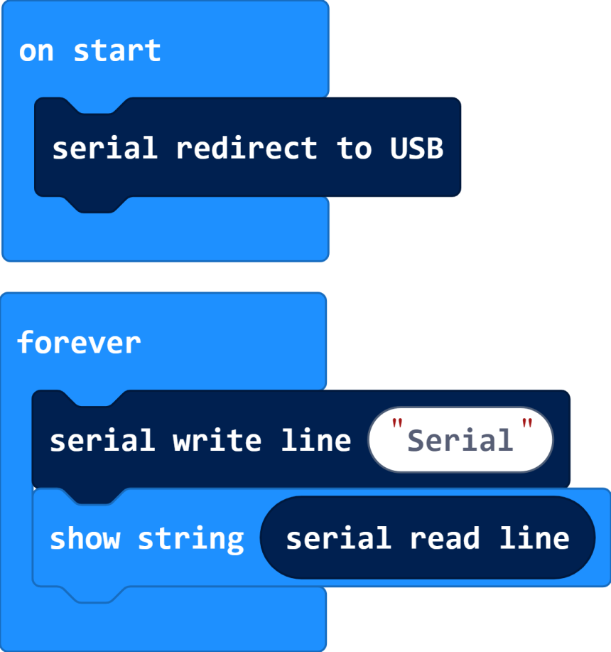
Serial

Slide 25
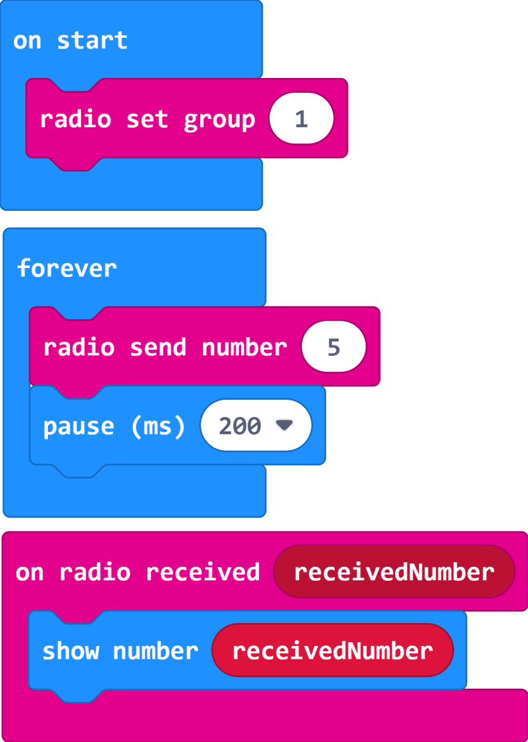
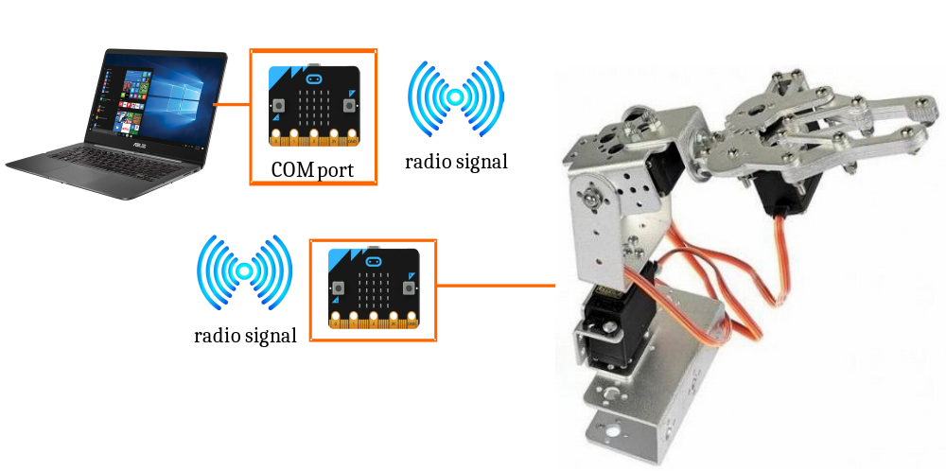
Radio
Communication bridge: 2 micro:bits

Slide 26
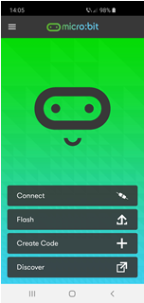
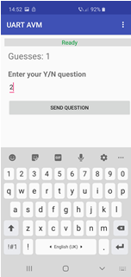
Bluetooth
Controlling the micro:bit from a Phone App
BLE: Bluetooth Low Energy
Bluetooth extention (OR radio extension OR bluetooth)
UART: Universal asynchronous receiver-transmitter
Phone App

Slide 27
4. Inputs and outputs

Slide 28
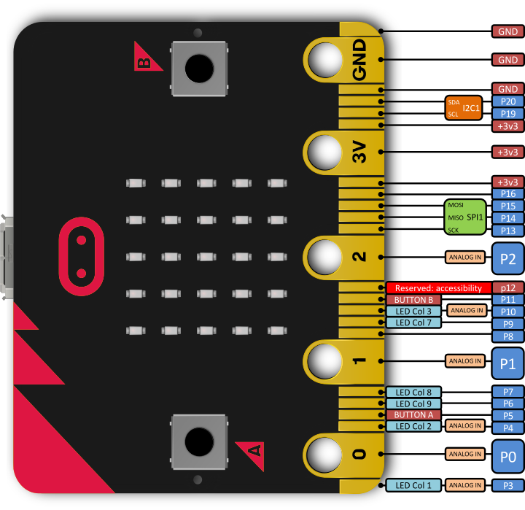
Pins
The micro:bit has 25 external connections on the edge connector of the board, which we refer to as ‘pins’.
21 pins
5 LARGE pins
Analogue and digital

Slide 29
Types
GPIO: general purpose digital input and output
ADC: analogue to digital converter
3V: 3 volt power output or power input
GND: attaches to ground in order to complete a circuit
SPI: Serial Peripheral Interface bus (3-wire): MOSI (Master Out Slave In), MISO (Master In Slave Out), Chip Select
I²C: Inter-Integrated Circuit bus (2-wire): SCL (clock signal) and SDA (data line)

Slide 30
Analogue to digital converter
The pins of the board cannot output/input analog signal in the way an audio amplifier can do it – by modulating the voltage on the pin.
Those pins can only either enable the full 3.3V output, or pull it down to 0V.
However, it is still possible to „produce” an analogue signal by switching that voltage on and off very fast, and controlling how long it is on and how long it is off. This technique is called Pulse-Width Modulation (PWM).
Analogue values: 0 – 1023
Duty cycle: for example the value 511: the power is on half of the time, and off half of the time. The result of that is that the total energy of this signal is the same, as if it was 1.65V instead of 3.3V.

Slide 31
The value of the pins
Digital pins:
  0 (0V)
  1 (3.3V)
Analogue pins:
  0 – 1023 range PWM signal
Pull state: a pin is configured with a pull-up or pull-down resistor. No_PULL: the pin will float
  UP (1)
  DOWN (0)
  No_PULL (2)
Touched: the pin is being touched with a finger. This test is done by measuring how much resistance there is between the pin and ground.
  True
  False
The pull mode for a pin is automatically configured when the pin changes to an input mode.
Notes:
No_PULL: In other words, it's not being pulled to any specific voltage level. This configuration can be useful in certain situations where you want the pin to be sensitive to changes in its environment without any external bias.

Slide 32
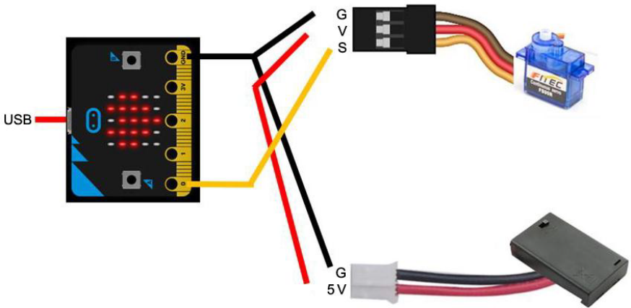
Important!
The pins labelled 3V and GND relate to the power supply of the board, and they should NEVER be connected together.
If we use an external power supply for a motor or for a sensor or for a device, we have to connect ALWAYS the device’s ground to the micro:bit ground (pin GND).

Slide 33
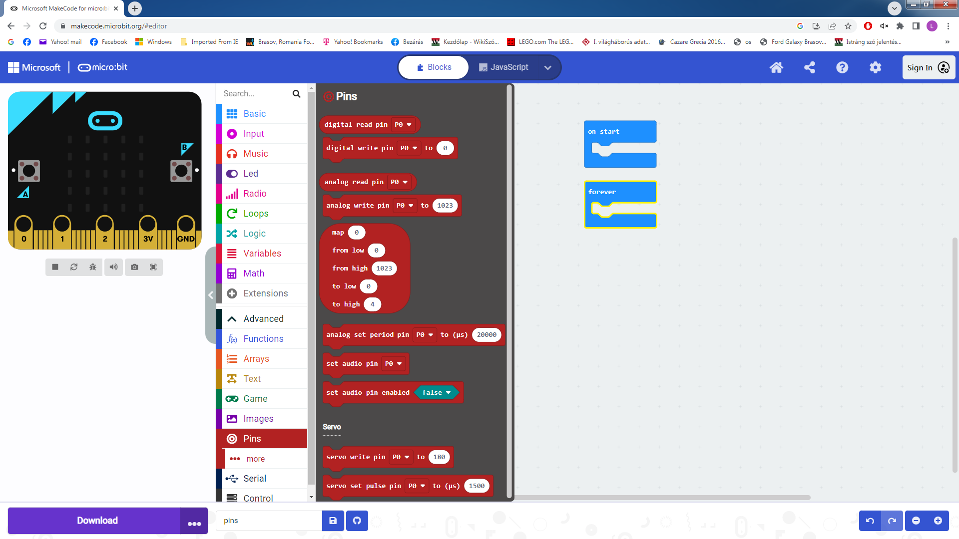

Slide 34
Thank you for your attention!
Questions?

